Slide 1
What’s going on with our climate?
3 words
Unfamiliar
Unprecedented
Urgent
Notes:
1

Slide 2
Unfamiliar Unprecedented Urgent
‘It’s just not behaving like it used to’
It’s hotter
Rain is more variable
More extremes
Hot days
Total Rain
Intense Rain
Hot nights
Two major region wide droughts in last decade (2009-10, 2013-16)
All temperature indices for the Caribbean are all increasing
~23 more ‘hot’ days and nights i.e. earlier and longer summers
(1) Very variable rainfall pattern + some places getting wetter, some getting drier +
(2) ‘nature’ of rain is changing
Peterson et al. (2002); Stephenson et al (2014) Herrera et al (2017)
Notes:
2

Slide 3
Unfamiliar Unprecedented Urgent
‘It’s just not behaving like it used to’
Our development pillars are becoming unreliable
Notes:
3

Slide 4
Unfamiliar Unprecedented Urgent
‘It’s just not behaving like it used to’
Development pillars are ‘Unreliable’
Notes:
4

Slide 5
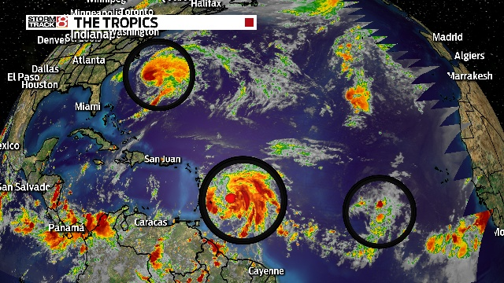
Unfamiliar Unprecedented Urgent
‘It’s like we’ve never seen before’
Irma
Heavy rain: Leeward Islands to USA
Peak intensity of 185 mph (295 km/h) Ties as the 2nd-strongest Atlantic hurricane by wind speed (only after Allen of 1980)
Becomes Cat 2 hurricane in 24 hours. Sustained 185 mph (295 km/h) winds for 37 hours. Only tropical cyclone worldwide to have had winds that speed for that long
First recorded Category 5 hurricane to affect the northern Leeward Islands,
2017 Hurricane Season
Maria | Peak of 175 mph max winds in the eastern Caribbean 3rd strongest max winds in eastern Caribbean (after Irma and Allen in 1980) | Explosive strengthening. 70 mph max wind intensification in 18 hours
Notes:
5

Slide 6
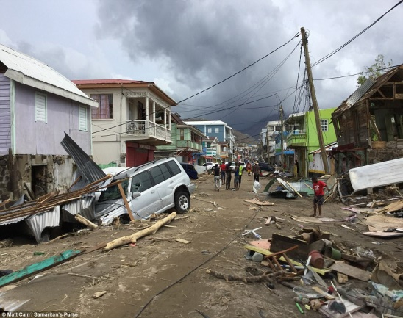
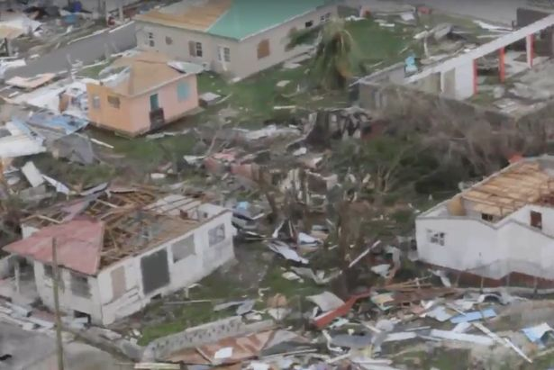
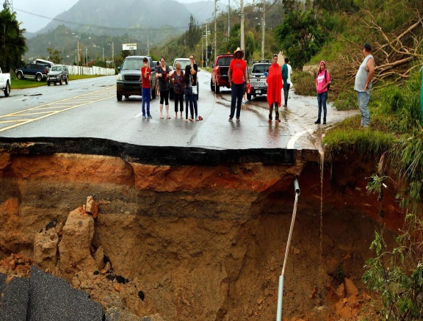
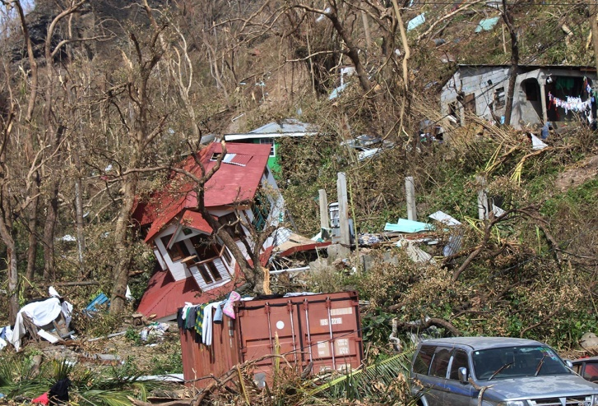
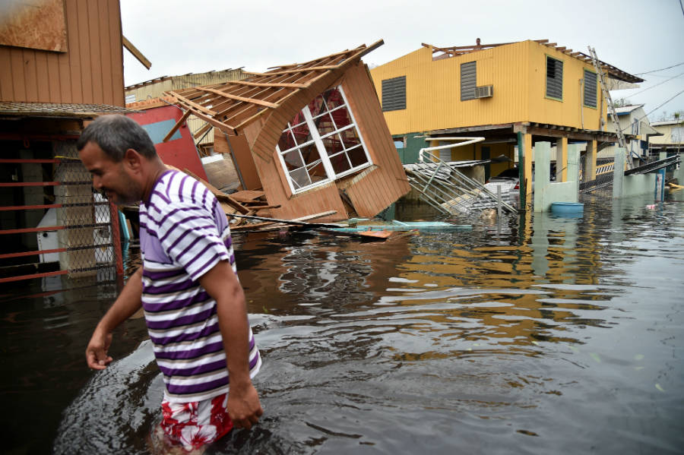
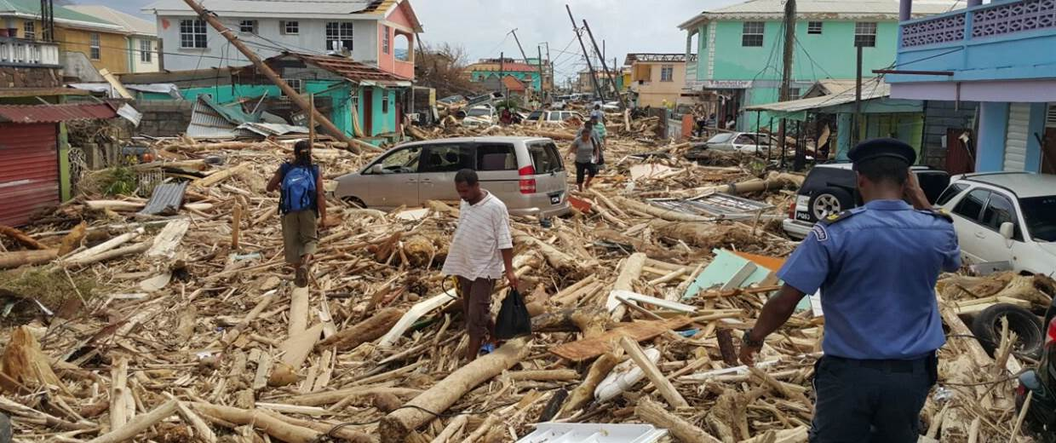
Unfamiliar Unprecedented Urgent
‘It’s like we’ve never seen before’
World Travel & Tourism Council (WTTC)
THE IMPACT OF THE 2017 HURRICANE SEASON ON THE CARIBBEAN’S TOURISM SECTOR
“Research suggests that recovery to previous levels could take up to four years, and if this is the case, the region will miss out on over US$3 billion over this timeframe.”
Unprecedented climate = unprecedented impacts!
Notes:
6

Slide 7
Unfamiliar Unprecedented Urgent
‘It’s like we’ve never seen before’
In an era of unprecedented climate our development goals i.e. the things that determine quality of life are further set back.
Development goals threatened by climate
Notes:
7

Slide 8
Unfamiliar Unprecedented Urgent
‘It’s just not behaving like it used to’
‘It’s like we’ve never seen before’
Development pillars are ‘Unreliable’
Development goals are ‘Unattainable’
Notes:
8

Slide 9
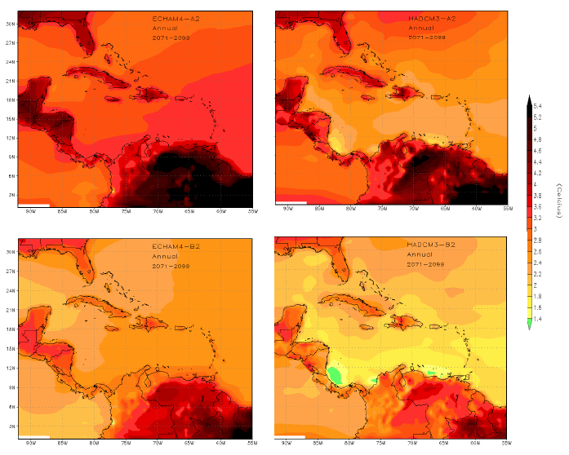
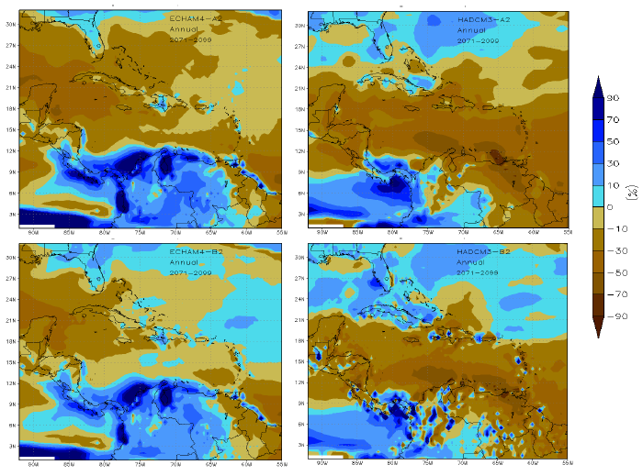
Unfamiliar Unprecedented Urgent
‘It’ requires us to do something now!’
…even hotter times
…even drier conditions
…more intense extremes
1-4 degrees by 2100
30-98% of days annually will be ‘hot’ by the 2090s
Only 2% ‘cool’ by the 2080s
Still variable but less
~40% drier.
Shorter rainy season
Longer, more severe droughts
Storms, with higher rainfall rates and stronger winds.
Campbell et al. (2010); Karmalkar et al. (2013); Taylor et al (2013); Taylor et al. (2018)
Notes:
9

Slide 10
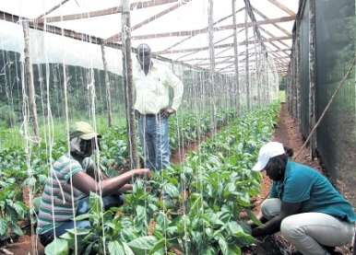
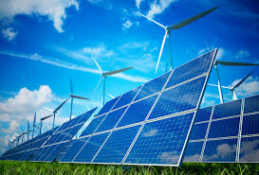
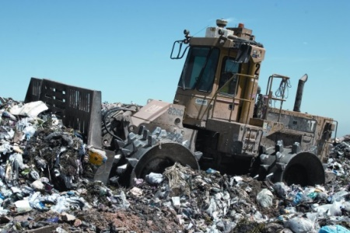
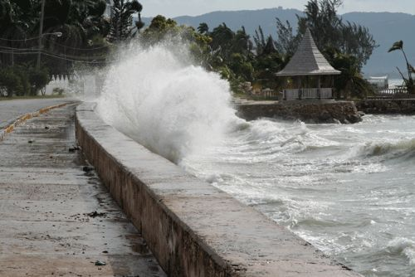
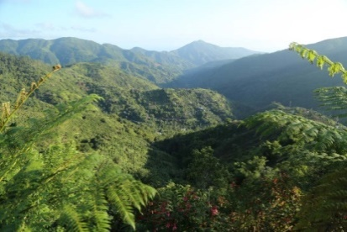
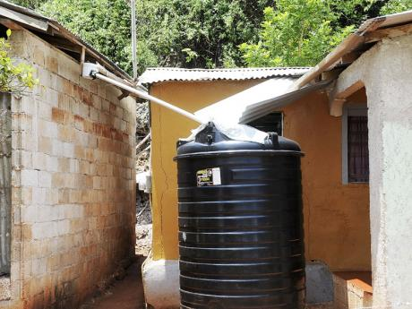
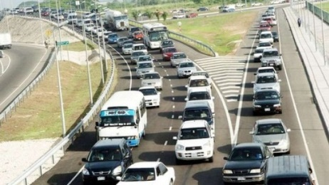
Unfamiliar Unprecedented Urgent
‘It’ requires us to do something now!’
Mitigation
Adaptation
Education
‘…changing so we reduce the amount of greenhouse gases we put in the atmosphere’
‘…changing in order that we and others can live with the changed climate’
‘…climate smart citizenry’
Farming practices
Energy
Waste
Building
practices
Conscious, convinced & convicted about the issue
Forests
Water harvesting
Policy
Forests
Resilience
Transportation
Notes:
2017’s lesson: “We have to push for greater mitigation regionally and globally (1.5 to stay alive) to offset the worst future possible.”
2017’s lesson: “We all need to be aware of the magnitude and scope of climate change’s impact on us as small island dwellers and use that knowledge to drive action for the common good”
10

Slide 11
Unfamiliar Unprecedented Urgent
‘It’s just not behaving like it used to’
‘It’s like we’ve never seen before’
‘It’ requires us to do something now!’
Development pillars are ‘Unreliable’
Development goals are ‘Unattainable’
Development Agenda will be ‘Untouchable’
Notes:
11

Slide 12
Thank You
Notes:
12

