Slide 1


The re-engineered work environment
Zia Paton, Digital Services Leader PwC in the Caribbean
25 June 2021

Slide 2

Highlights across three key drivers:
ESG
Future Skills
Digital

Slide 3

ESG
Environment. Social. Governance.

Slide 4
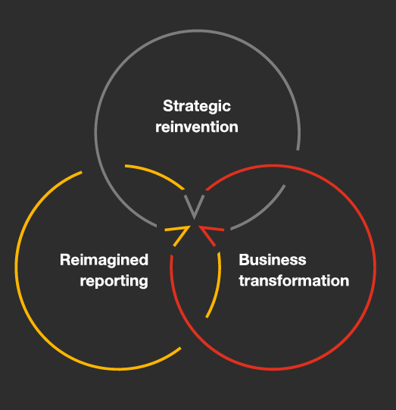
The ESG revolution is here...
Societal need and business opportunity are coming together to transform the way companies craft strategy, drive performance and report results.
The re-engineered work environment will consider all elements of ESG.
Finance Professionals need to be ready to support the change to:
Enable measurement and management of ESG factors such as carbon emissions, workforce diversity and supply chain sustainability.

Slide 5

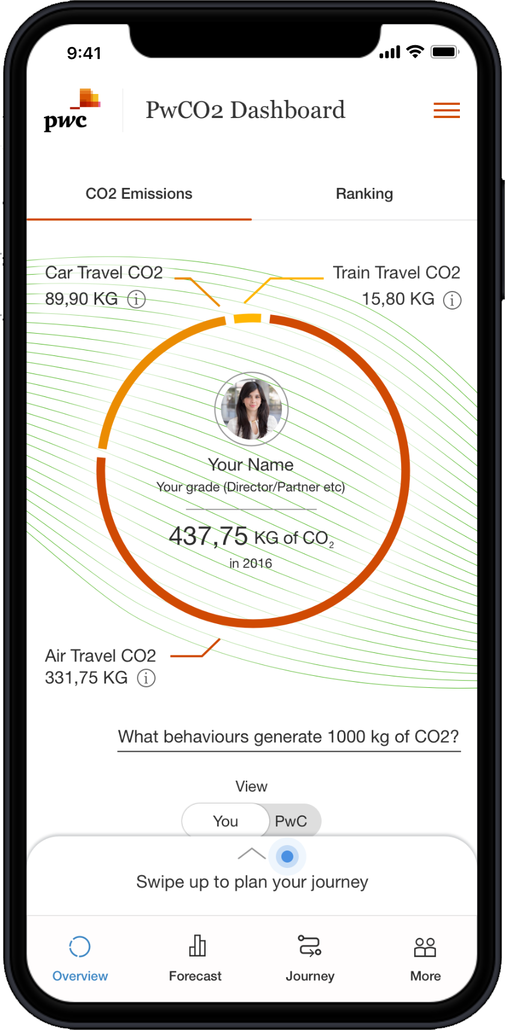
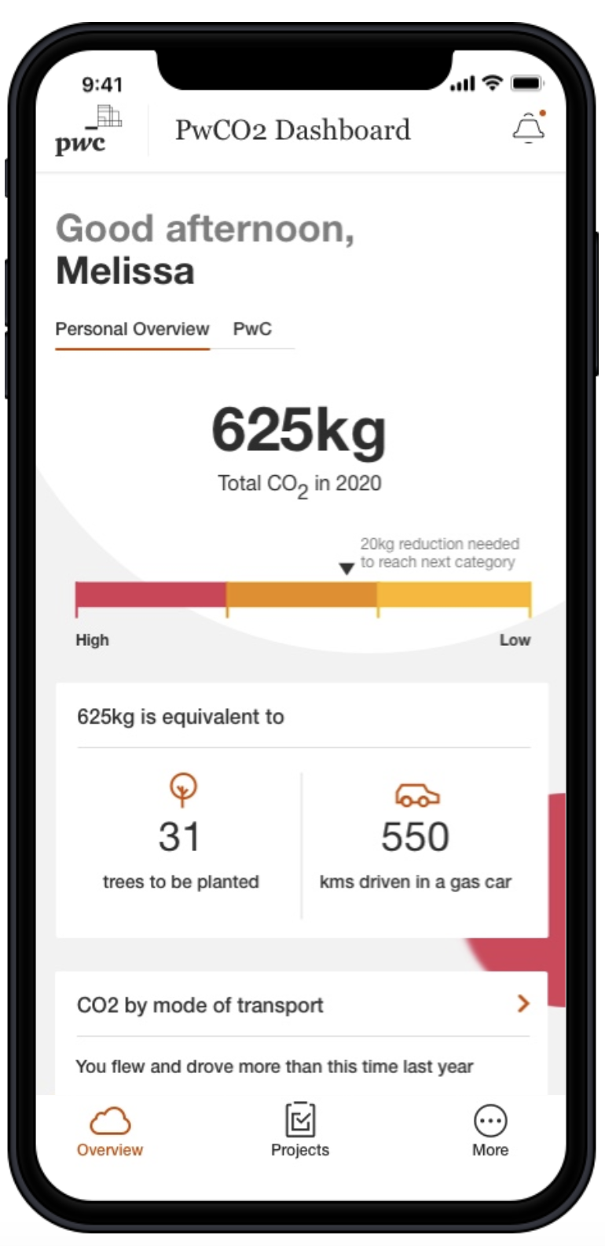
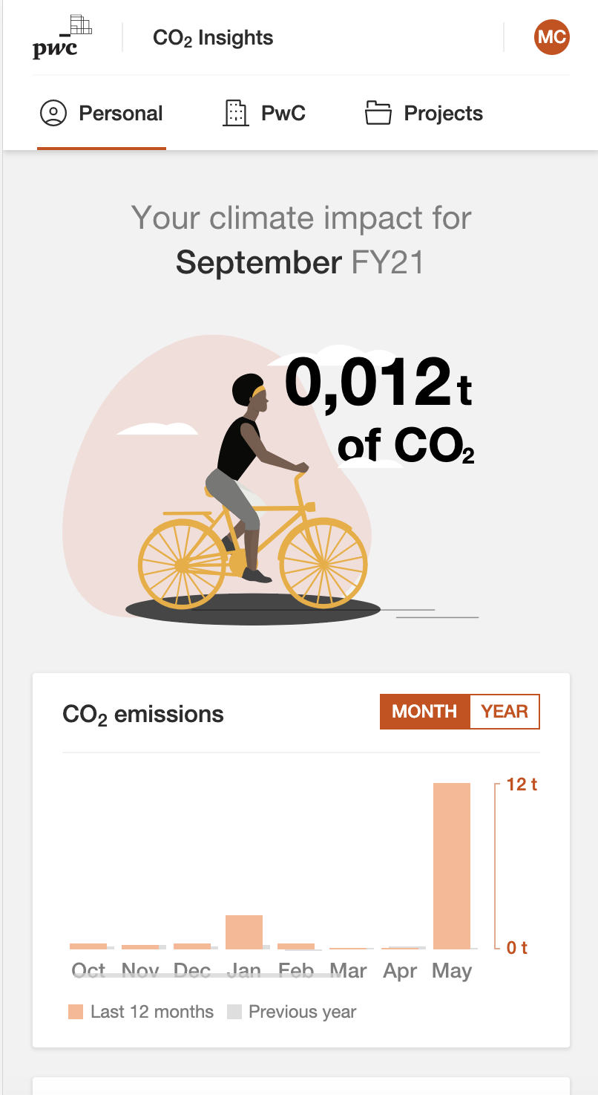
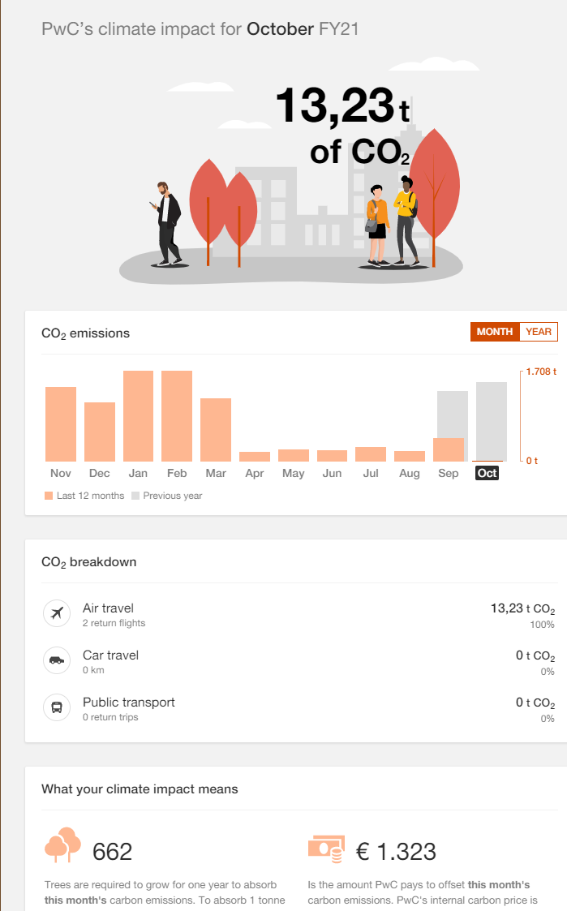
Environment
With the signing of the Paris Agreement to achieve Net Zero Carbon Emissions by 2030, companies across the world including Trinidad and Tobago are measuring their footprint and putting measures in place for reduction.
At PwC we have made the commitment to Net Zero by 2030 and are using tools which are available to our client to support tracking and decisions.
Finance professionals in the Caribbean will be called on to support measurement and monitoring in the very near future if you have not already.
PwC tool:
Environment
Footprint Insights

Slide 6

Social
Social network are stronger than ever in the Digital Age and implications for businesses are significant.
Organizations are required to have a strong social character that is reflected in the way they do business. Recent social issues around diversity has had negative financial implications for businesses.
Finance professionals must work with the wider the business to ensure a strong social character that is embedded across the business and reflected in the public domain.

Slide 7

Governance
The Finance and Accounting profession is no stranger to governance and thrive on adherence to standards, rules and regulations.
The ESG revolution is driving even deeper requirements for strong governance across the entire business.
Multilateral funding agencies and financial institutions have adopted policies that require strong governance arrangements particularly in finance functions prior to loan disbursement. They are imposing limits on funding certain sectors and increased funding in other sectors that support the ESG revolution.
Finance professionals must inform and support business decisions that could impact funding arrangements.

Slide 8

Future Skills

Slide 9

Workforce transformation agendas are even more critical now to survive and sustain after this crisis.
Four lenses:
Government and policy setting
1
Company level
2
The path to recovery requires diligent, and systematic, implementation of workforce and digital transformation strategies
Individual level
3
HR function/HR departments
Source: World Economic Outlook, IMF, April 2020
4

Slide 10
Building a workforce of the future
The task of building the future skills will require active collaboration between HR functions and business units like finance. Finance professionals should be active adopters and advocates for future skills
Five building blocks
Assess current environment & identify skills gaps and mismatches
Build a future-proof skills strategy
Lay the
cultural foundation
Develop and implement upskilling
Evaluate return on investment
Source: World Economic Outlook, IMF, April 2020

Slide 11

Finance Professionals must accelerate understanding and development of future skills
In addition to traditional skills and qualifications, Future Skills required of the finance and accounting profession may include:
Sample of future skills:
Data Analytics (including use of key tools)
Design Thinking
Working with Visualization Tools
Real Time Analytics
Core data visualization concepts
Data modelling and preparation
Access Management/Control
Automating Routine Reports
R scripting in Power BI
Python scripting in Power BI
PwC tools to support you:
ProEdge: One platform to assess gaps and fill them through personalised upskilling for each person.
FREE diagnostic tool:
Workforce Strategy Diagnostic

Slide 12
Case Study Trinidad and Tobago: Job Evaluation and Compensation Exercise in across Civil Service
VISION 2030
GOOD GOVERNANCE & SERVICE EXCELLENCE
The Exercise
The Outcome
250 Benchmark Positions
1,451 Other Positions
A Classification and Compensation System that is:
efficient and effective
technically sound
flexible and easily updated
able to support the current and future needs of the Service
CIVIL SERVICE
Diagnostic Assessment
THA
STATUTORY AUTHORITIES
33,000
40
Job Analysis
Ministries | THA | Other
Employees
(Establishment)
8
1,651
Develop Job Descriptions
Stat. Authorities
Positions
Job Eval | Web based JE System
Vision 2030
High performing Public Service
Institutional transformation
Inclusive, objective, transparent operations
Effective functioning of the Service is impeded by the current
Classification and Compensation System:
Est. since 1960’s
Misaligned with current requirements of a modern day Service
Need for greater flexibility in response to change
Compensation Survey
Transition / Implementation
September 2020

Slide 13

Digital
(sharing the PwC Story)

Slide 14
Digital Adoption - What worked then, won’t work now - there has been a shift in mindset
The adoption of digital technologies is key to realising the new vision for CFOs. Finance teams need to be at the forefront of each emerging ‘pillar’ of technology:
Analytics: the explosion of data inside and outside the organisation
Cloud: running the entire business from cloud
Collaboration: digital tools and apps revolutionising how teams work together
Robotic process automation (“RPA”): the adoption of virtual worker software to drive automation
Human Interactions have changed
Expectations have changed
Engagement have changed
Notes:
https://www.involv-intranet.com/9-internal-communication-trends/
https://www.snapcomms.com/blog/internal-communications-trends-2019#targetText=They%20offer%20a%20modern%20and,and%20simplify%20use%20for%20employees
31% stat https://www.snapcomms.com/blog/internal-communications-trends-2019#targetText=They%20offer%20a%20modern%20and,and%20simplify%20use%20for%20employees

Slide 15
The Re-engineered environment at PwC:
People and Technology Driven
We have invested USD3bn to upskill our entire 275k workforce around the globe.
Invested in new and enhanced tools and technology to support serving our clients in Audit, Tax and Advisory
Developing proprietary PwC digital products like ProEdge and many others to support solving client issues.
Working closely with Global Alliances like Oracle, SAP, Salesforce, AWS, Microsoft etc to bring leading digital technology and successful adoption to clients
Deepening network connections across PwC’s global network to support delivery of local global digital services

Slide 16
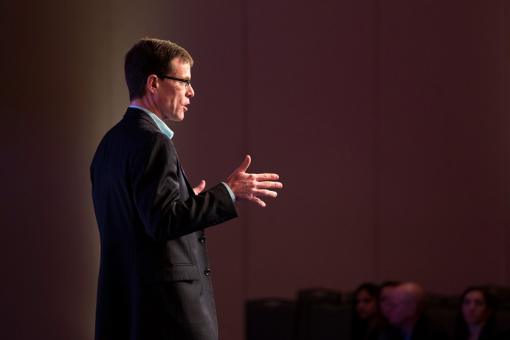
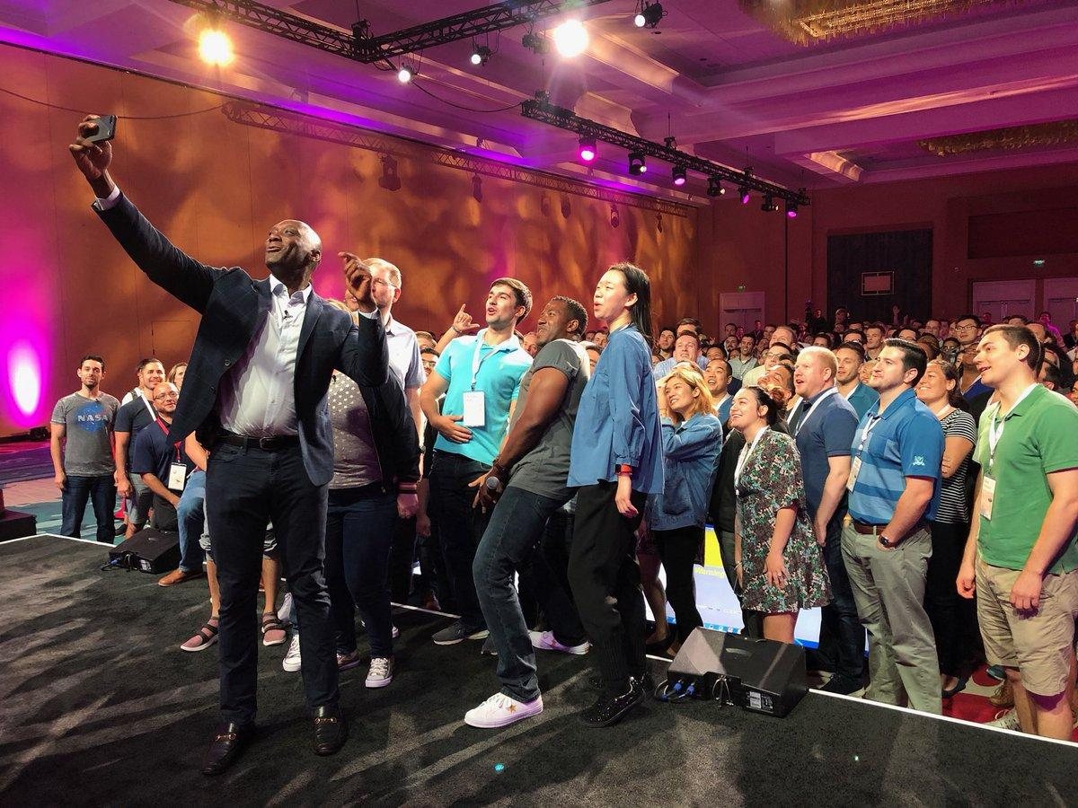
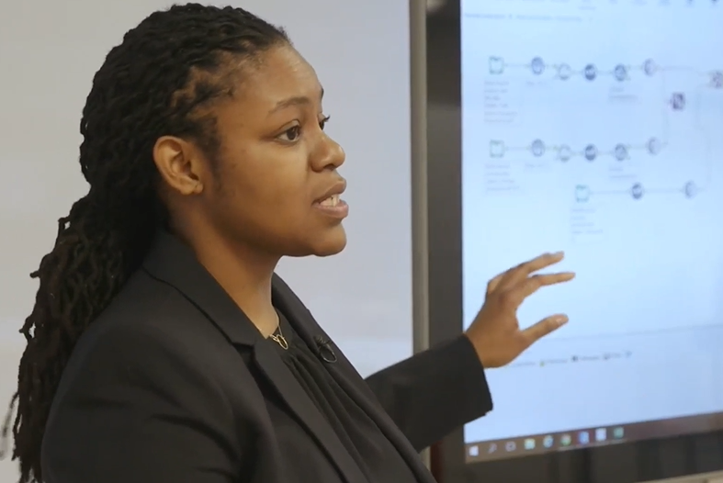
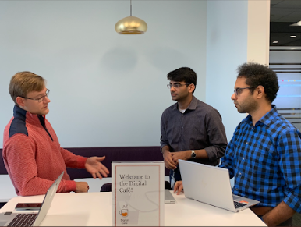

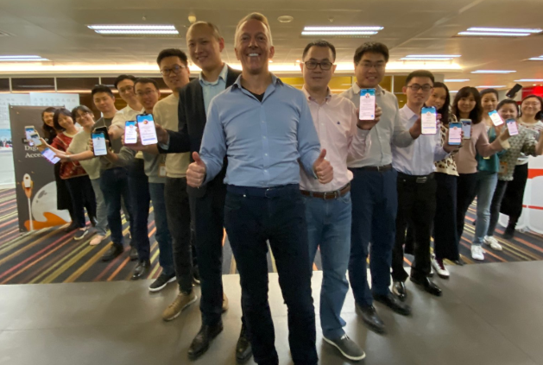
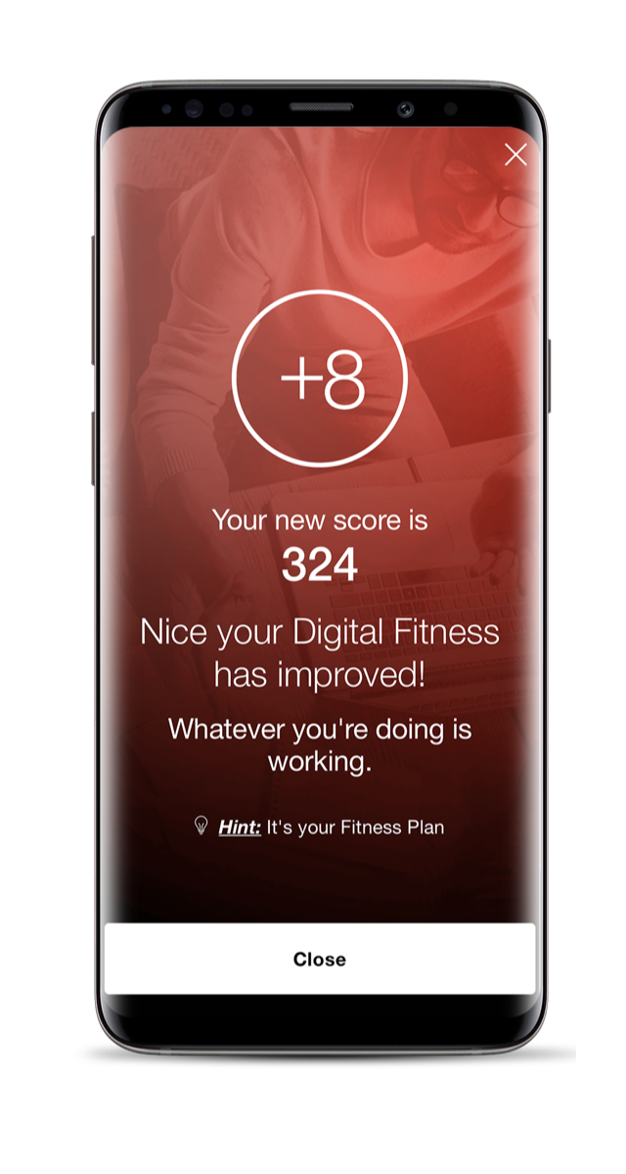


The Re-engineered environment at PwC: Upskilling everyone
Digital journey...no one left behind!
Your Tomorrow program
Offered to all staff
Upskilling foundation & acceleration
Digital Fitness App
Digital Accelerator
Digital Academies
Digital Acumen knowledge badge
Platforms and tools
Data Platform, Digital Lab, and Workbench
Staff training on advanced tools such as UiPath, Alteryx, Tableau, Google Data Studio, PowerBI and PowerPivot
Upskilling at scale
Digital Learning Paths for skill badges
Digital Cafe for one on one coaching on digital tools.
Human-centered Design
Up-knowledge, Up-skill, Up-perform
Firm to Table Challenge where meals were donated for upskilling activity and progression in Digital Lab engagement.
New world. New skills. global program
Your Tomorrow success has launched a global effort to digitise the entire network strategically
Source: World Economic Outlook, IMF, April 2020

Slide 17
The Re-engineered environment at PwC: Caribbean
Our initiatives have created a buzz around learning in the region
52
Digital Champions charged as change agents in leading the Digital Upskilling program
900+
Employees digitally upskilled across the region
25,000+
Hours invested by our people in Digitally Upskilling
270+
Digital Assets created in the region
Source: World Economic Outlook, IMF, April 2020
Notes:
- 6,000 hours saved to date based on solutions submitted
- 24,000 hours saved to date based on projecting the number of times the solution can be shared/ used
However, this is not very accurate data and I don't know if we want to tell the market we're removing hours given I don't think we're reducing our fees.

Slide 18
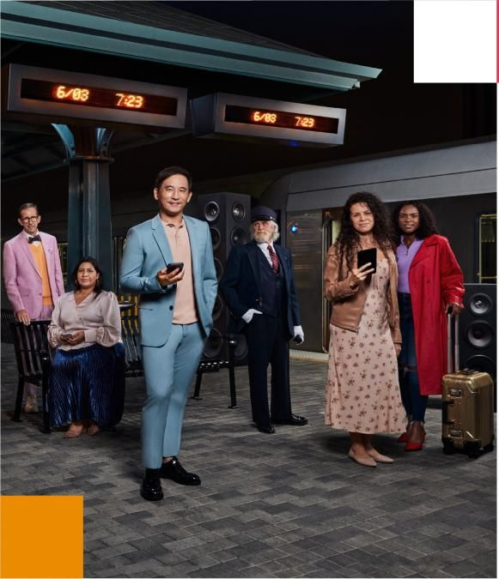
The Re-engineered environment requires constant reflection and evolution….
PwC’s latest strategic agenda focuses on the New Equation…. People hardwired to find solutions, wired with the latest technology.
Your strategy is likely to have a similar focus as we all adapt to changes around us.
Notes:
Delivering #TheNewEquation means continuing our strategy of being human-led and tech-powered. Learn how we’re investing in emerging technologies and what it means for our clients and stakeholders. https://pwc.to/3xbFrVp
Our new strategy is relentlessly focused on our clients, helping them build trust and deliver outcomes for their businesses.
The successful organisations of the future will be the ones that create a virtuous circle between building trust and delivering sustained outcomes. That's what #TheNewEquation is all about."

Slide 19

The re-engineered work environment
Act now.
This isn’t about some ‘far future’ of work – change is here and accelerating.

Slide 20
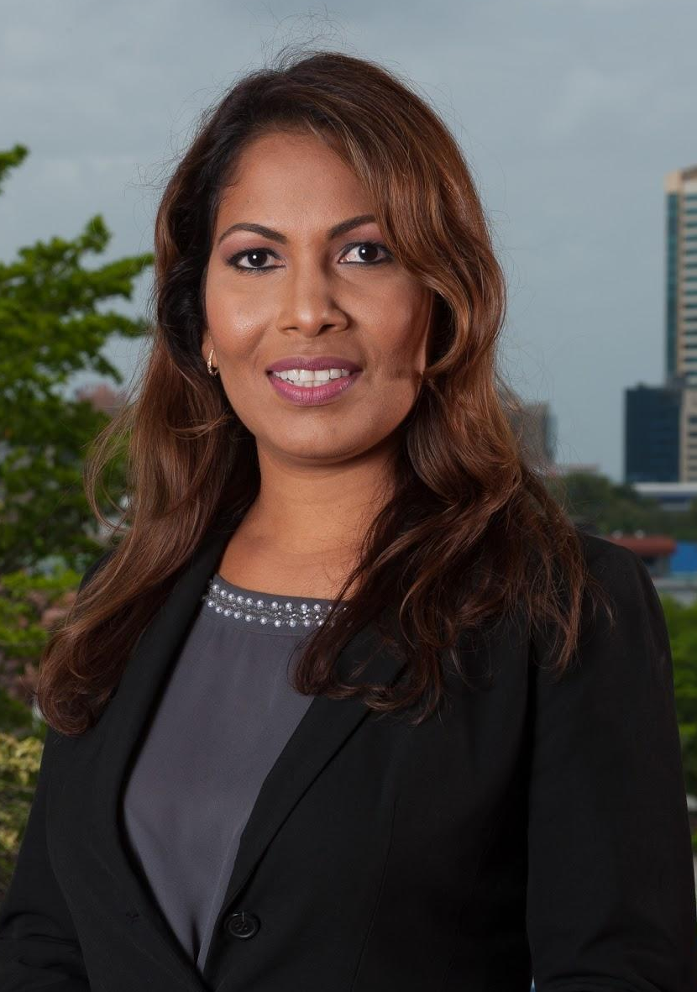
Thank you
Zia Paton
Digital Services Leader, PwC in the Caribbean
Joint Consulting Leader, Southern Caribbean PwC
zia.paton@pwc.com
pwc.com/cb
This content is for general information purposes only, and should not be used as a substitute for consultation with professional advisors.
© 2021 PwC. All rights reserved.
PwC refers to the PwC network and/or one or more of its member firms, each of which is a separate legal entity. Please see
www.pwc.com/structure for further details.

