Slide 1



37th
Caribbean Conference of Accountants
June 20th - 22nd 2019
Jamaica Pegasus Hotel
Kingston
The Cannabis Rush – a discussion
Who is reaping the harvest?
Proprietary & Confidential
2018 | CannaPiece Group

Slide 2
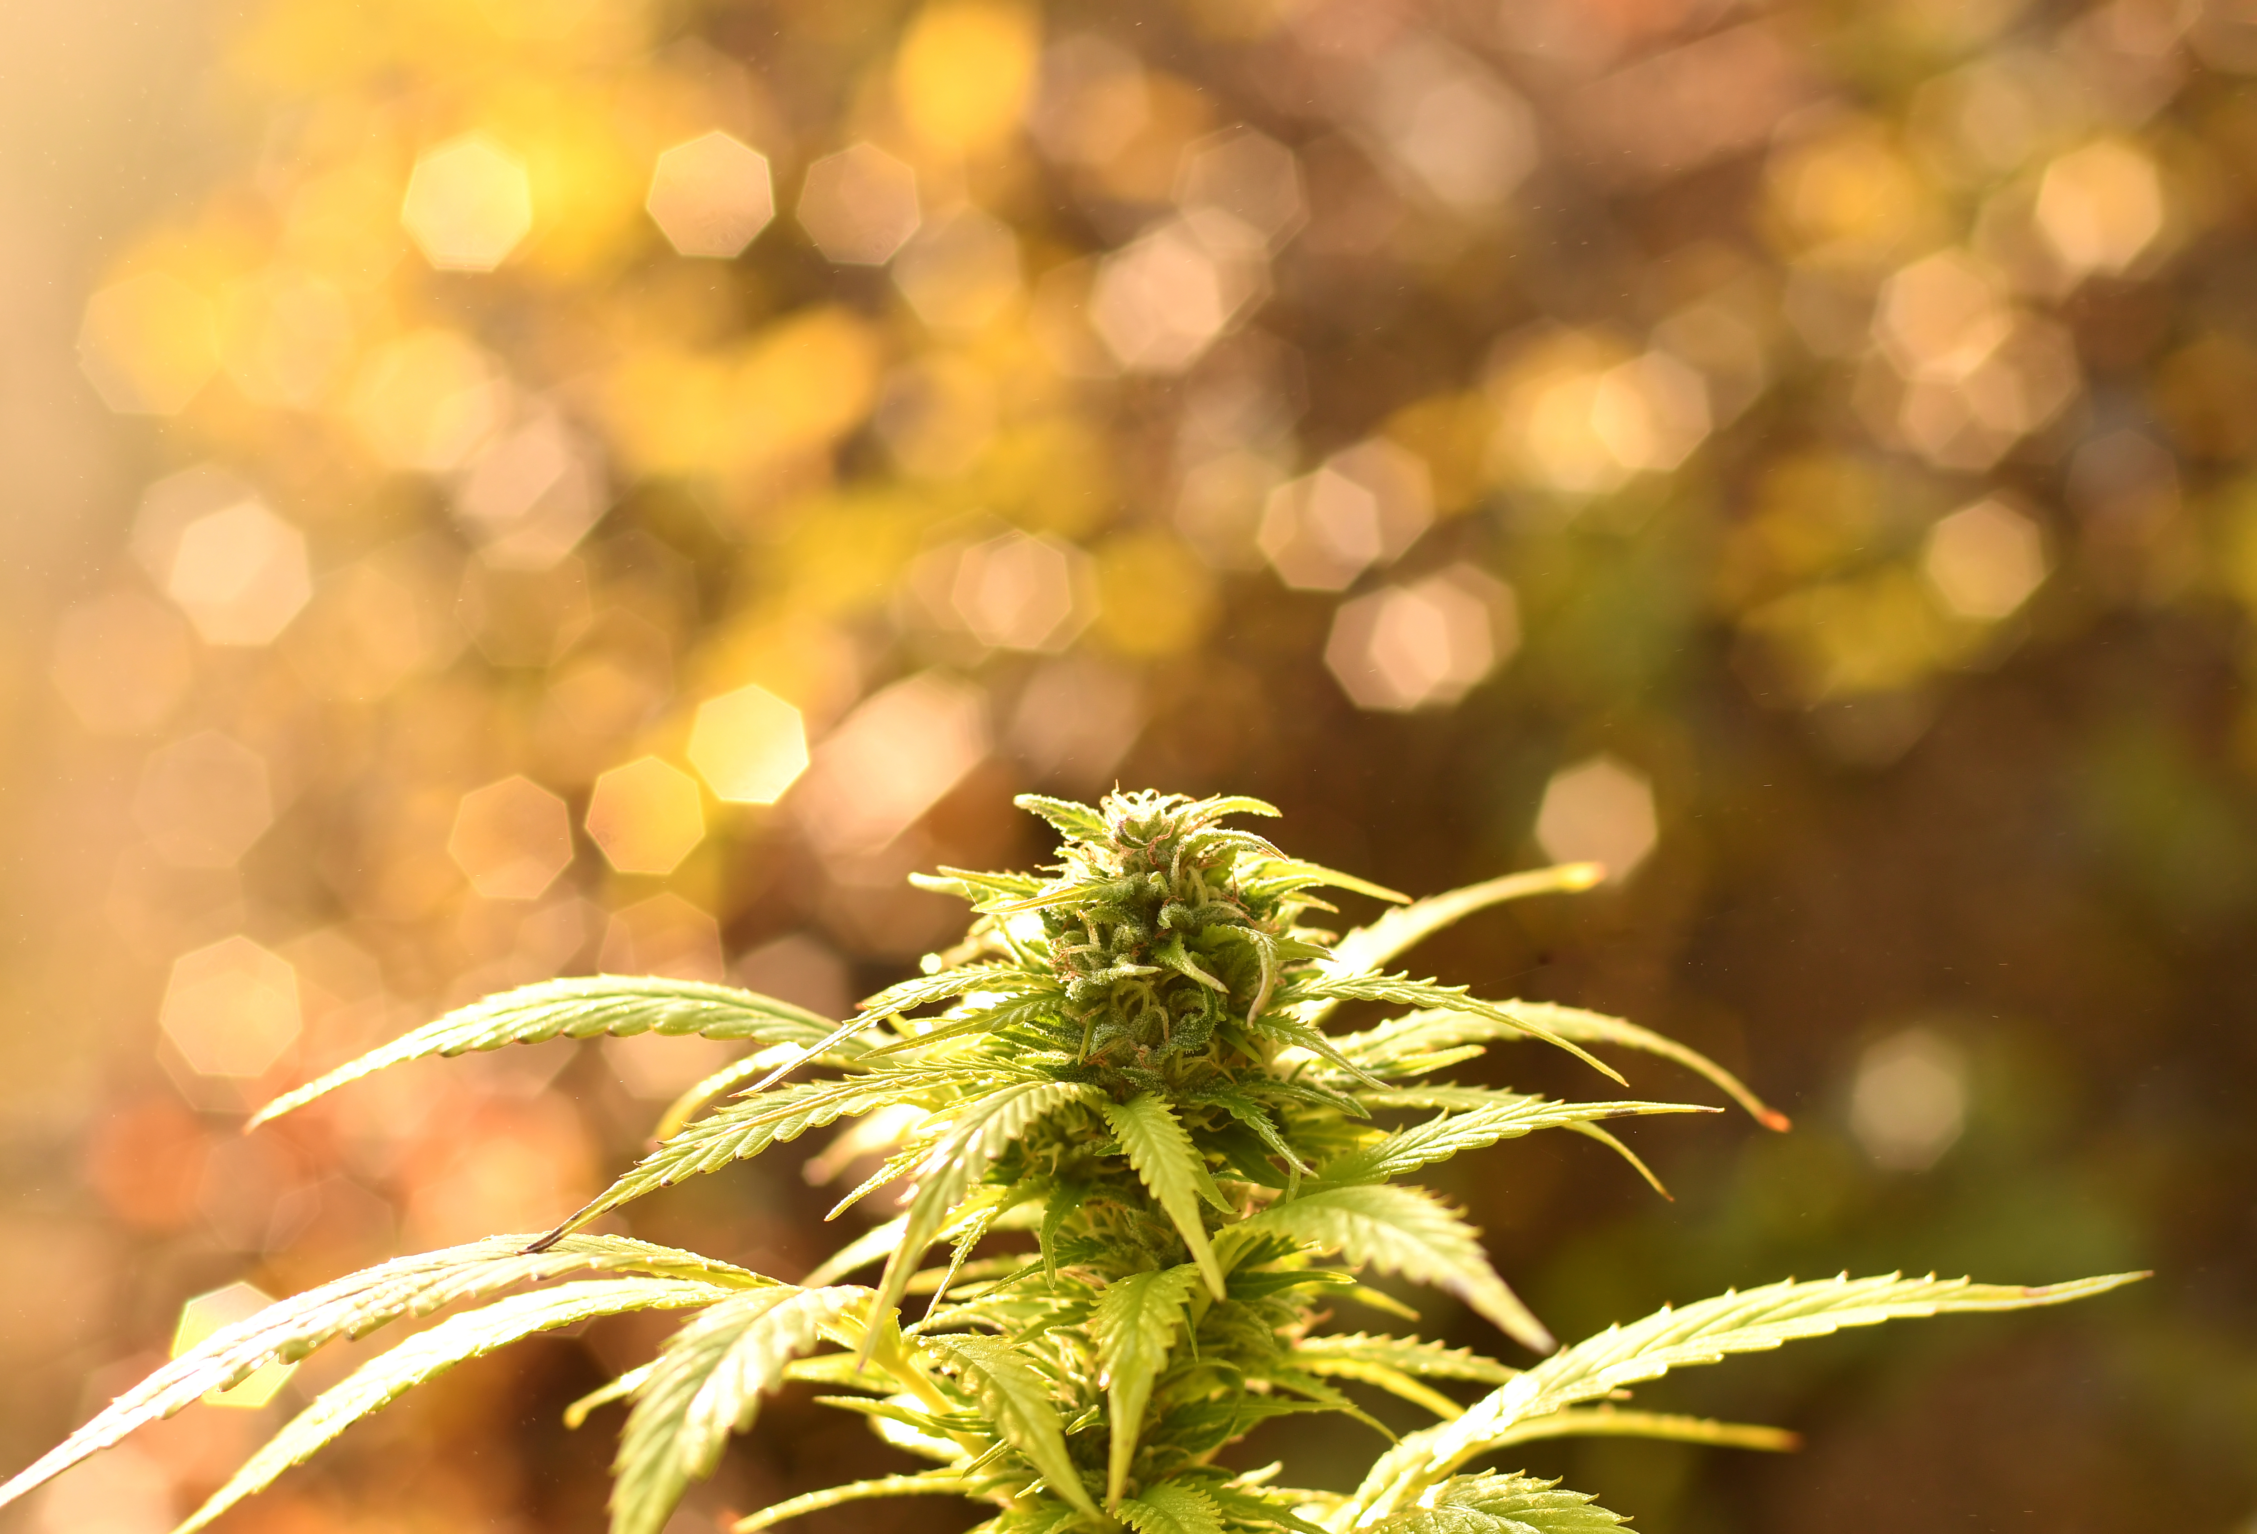

CannaPiece Group was established in May 2018 to capitalize on recent Canadian legislative developments related to the cultivation and distribution of medical cannabis. The Canadian industry is continuously being affected by legislation, changes to local and international markets and developments in the uses and acceptance of cannabis.
In April 2017, the Canadian government and Health Canada introduced Bill C-45 to amend the existing ACMPR regulations to allow for the granting of Micro Grow Cultivators (MGC) licenses to small companies and individuals. The new regulations will permit MGCs to grow and sell cannabis to other licensed producers, licensed retailors and storefront dispensaries, where applicable.
Our Mission
“To create a new standard in the cannabis industry as the most trusted & cost-effective licensed producer and operator of co-op grow facilities designed specifically to meet the needs of Canadian Micro Grow Cultivators (MGC).”
Our Vision
“Cannapiece Group plans to become the heart of the cannabis grower community and always at the frontier of innovation and superior quality cannabis worldwide”
About Cannapiece

Slide 3
GreySuits Advisory – Change is inevitable
At GreySuits we believe that value is created and protected through deliberate performance management, supported by advanced finance
systems and a mature finance function.
Many small and mid-sized companies going through change, need support that they might not think they can afford. Managing growth, transitioning from small to medium or from medium to large is tough. Often companies confront the reality that the existing resources, if not allocated correctly, might not be the right ones to successfully continue their long-proven track record of value creation and, in the worst cases, might fail to protect the value they have so successfully created until now.
GreySuits is a different kind of advisory firm
We help our clients identify risks and opportunities and to create and protect value through process improvements, growth strategies, cost savings and sound planning by using proven strategies, tools and
methodologies.
Our clients are:
financial institutions or their clients responding to a business circumstance (restructuring, forecasting);
❖ private equity firms seeking capable, ready senior financial and operating support to assist with operations reviews, due diligence or post-acquisition planning for potential and existing investments; and
❖ businesses preparing or confronting the next stage of their company’s development.
About GreySuits

Slide 4
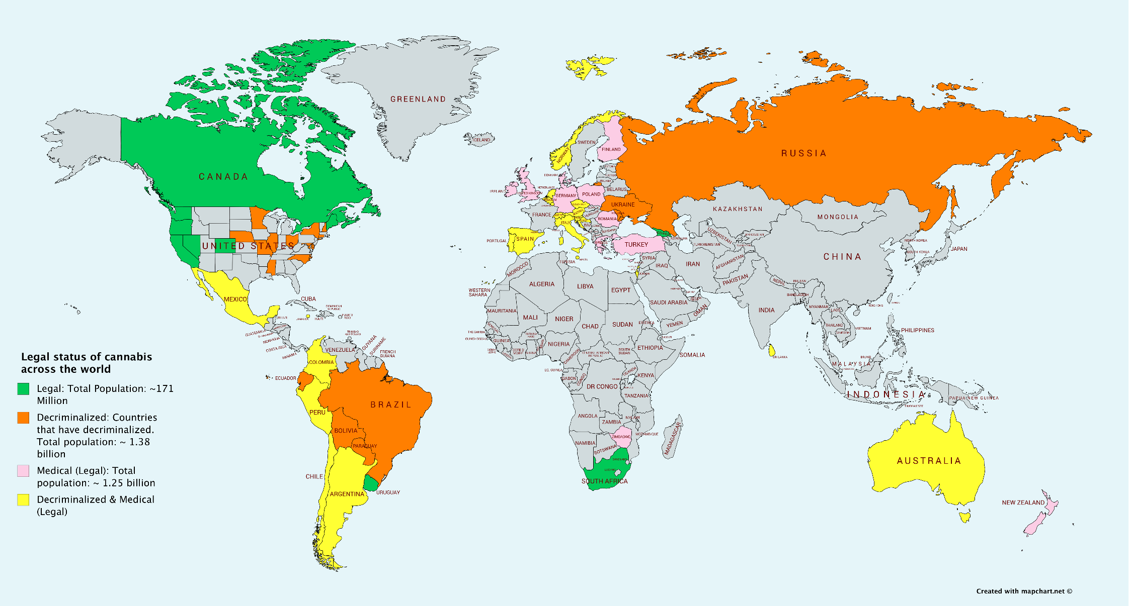
International Cannabis Market
Differing opinions on Global Market Size
Grand View Research projects the global cannabis market to grow at a CAGR of 34.6% reaching US$146.4 billion by 2025.
Bank of Montreal projects market to increase to US$200 billion by 2026
Barclays - European Consumer Staples Report in September 2018, estimates market could increase to US$272 billion by 2028

Slide 5
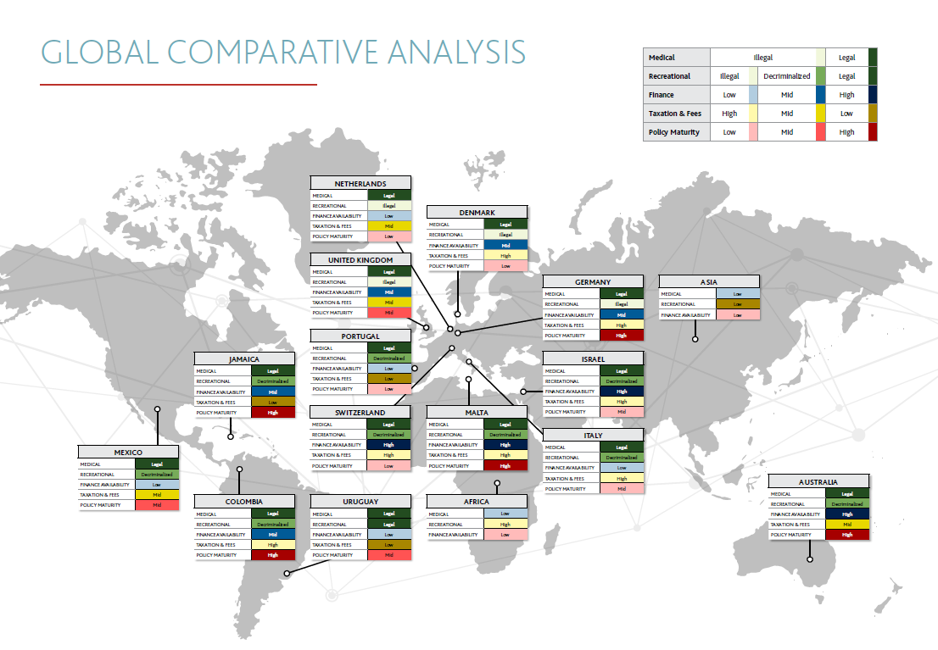
International Status of Legalization

Slide 6
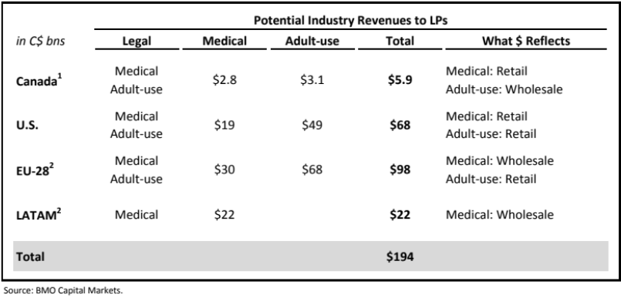
Estimated Global Market Size
BMO Forecasts for Total Addressable Markets in Seven Years
Canada: ~C$6bn
(Retail medical and wholesale adult use sales)
U.S: ~C$70bn
(Retail medical and retail adult use sales)
EU-28: ~C$100bn
(Wholesale medical and retail adult use sales)
Latin America: ~C$20bn
(Wholesale medical sales only)
Notes:
Source: BMO Report on Cannabis 2018

Slide 7
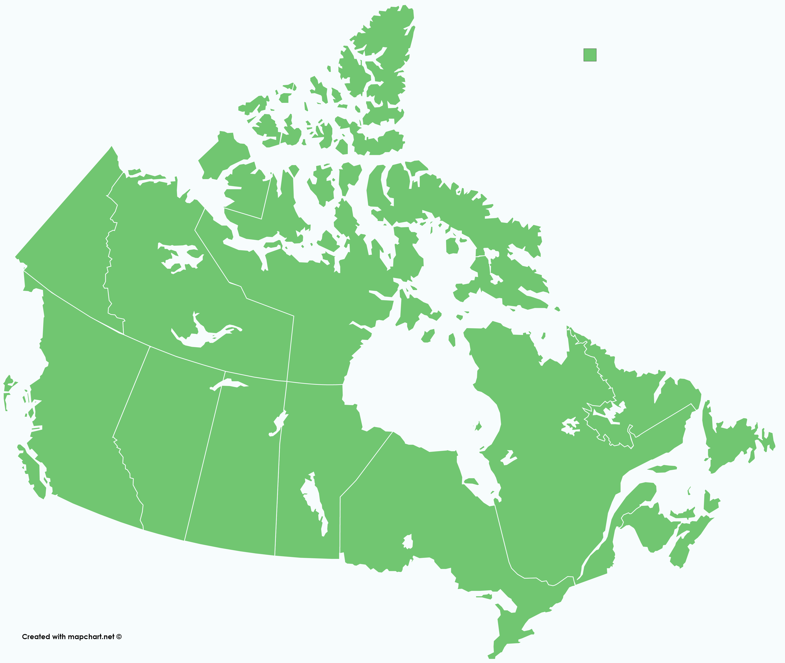
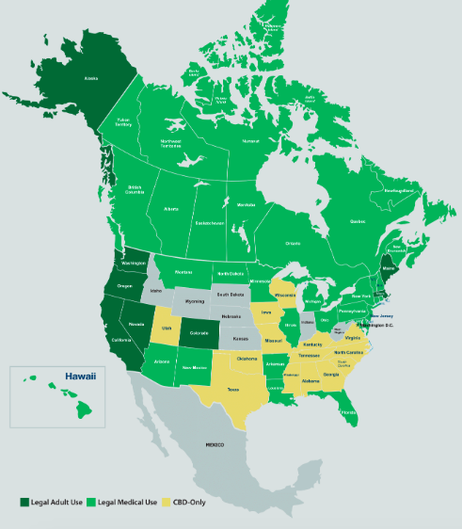
North American Cannabis Landscape
Current Market Overview
Canada:
There are currently 132 issued licensed producers in Canada.
The total cannabis market in Canada, including medical and recreational products is expected to generate up to $7.17 billion total sales in 2019
With legal sales contributing to more than half of this—up to $4.34 billion.
Overall consumption through legal channels is expected to continue to rise by up to 35 percent. The cannabis spend overall is also expected to rise by up to 58 percent, owing primarily to the fact that prices for legal products will be higher
Canadians who are already consuming cannabis expect to buy nearly two-thirds of their products from legal retailers
Source: Deloitte 2018 Cannabis Report
The Opportunity
Source: ArcView The State of Legal Marijuana Markets
Notes:
Sources:
- Deloitte 2018 Cannabis Report
- ArcView The State of Legal Marijuana Markets

Slide 8
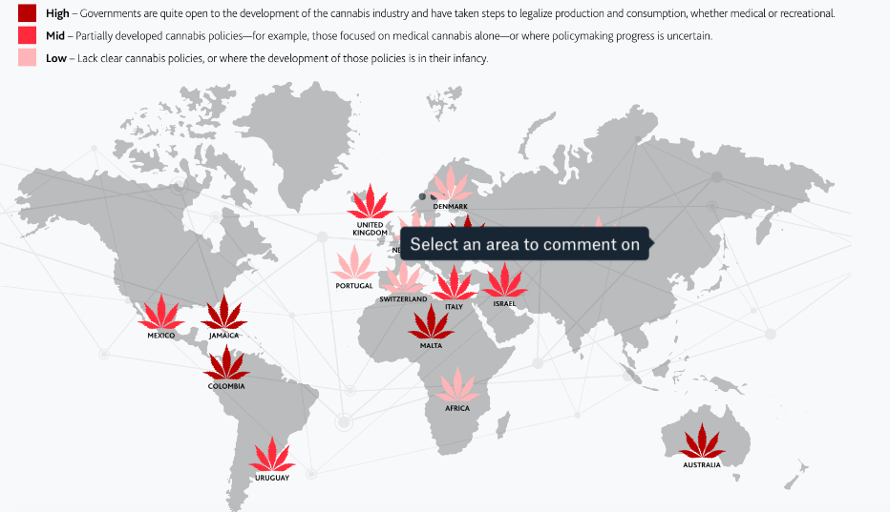
The Cannabis Opportunity for Caribbean Countries
Government Policy
  Governments are quite open to the development of the cannabis industry and have taken steps to legalize both medical and recreational production and consumption.
Notes:
Source: MNP Global markets

Slide 9
Public Opinion
Surveys done in five CARICOM countries by the well-known Caribbean Development Research Services Inc. (CADRES), reveal considerable shifting in public attitudes toward some form of law reform away from prohibition.
70% of people agreed, well only 22.6% disagreed with the ability to possess a limited amount of cannabis for personal use
88.4% of people agreed with cannabis use for medicinal and therapeutical purposes
Notes:
https://caricom.org/documents/16434/marijuana_report_final_3_aug_18.pdf

Slide 10
Caribbean countries exploring legalized cannabis
Jamaica
  As of August 2018, the CLA has issues 22 licenses and added 15 cultivation licenses in December 2018
  For example, Canada-based Jamaica Medical Cannabis Collective announced in September 2018 that it would invest $2 million to identify, analyze, and preserve Jamaica’s indigenous cannabis
Saint Vincent & The Grenadines
  December 11th 2018 decriminalizes cannabis for medical purposes and scientific research
Saint Kitts &Nevis
  Headed in the direction and considering possible legalization and law reform
Source: MNP Global Cannabis Markets 2019

Slide 11
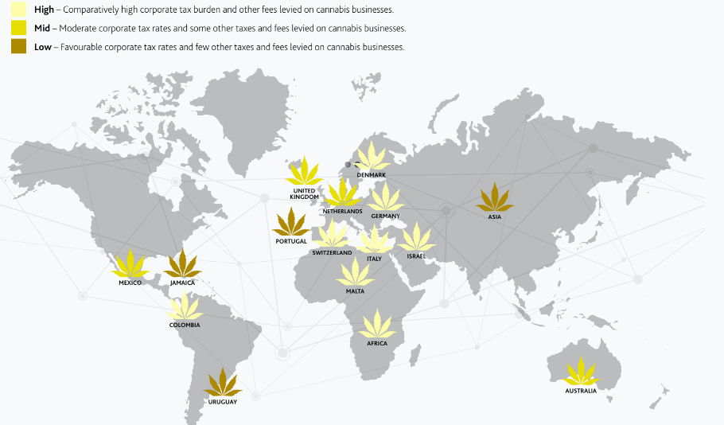
The Cannabis Opportunity for Caribbean Countries
Financing Opportunities
Comparative to Canadian cannabis firms, access to capital and financial services are somewhat accessible without foreign cannabis firms or institutions
Favorable corporate taxation rates and few other taxes and fees on cannabis businesses
A maturing market and rising M&A activity should also help investors and business leaders achieve more accurate valuations
It’s much like the early-2000s dotcom boom: How do you accurately value something that’s never existed before?
Notes:
Source: MNP global markets

Slide 12
Canadian Companies Currently Operating in Jamaica
Canopy Growth Corporation: In 2017 formed a strategic partnership in Jamaica, resulting in the establishment of a Tweed-branded venture to produce cannabis in the country.
The Green Organic Dutchman: formed a partnership with Jamaican company Grow House JA Ltd. and opened a flagship dispensary in the country.
Canadian-based Jamaica Medical Cannabis Collective: has signed contracts to provide Jamaican cannabis to three licensed producers in Canada.
Aphria Inc: announced in July 2018 that it was in the process of expanding its cannabis business to Jamaica by acquiring licensed producer Marigold Projects Jamaica Ltd.
Alliance Growers: announced in February 2018 that it had entered advanced negotiations for a significant strategic investment with a private licensed Jamaican cannabis company.
CROP Infrastructure Corp: announced a joint venture deal in July 2018 to operate a cannabis production site in Jamaica,
Cana Quest Medical Corp: In 2019 announced a preliminary agreement on global production and distribution with Jamaican Medical Cannabis Corporation, a Canadian-headquartered group of companies with expanding medical cannabis operations in Jamaica.
MediPharm Labs Corp.: In May 2019 entered a U.S. led opioid clinical research trial to develop FDA approved CBD gelcaps
Notes:
Source: MNP Global Cannabis Markets 2019

Slide 13
OBSTACLES CAN TRIP UP THE UNWARY
Opportunities abound, though under-developed regulations, varying attitudes and wide-ranging skills and professionalism of operators can lead to uncharted waters for many companies. Cannabis companies will need to stay on top of issues that could spell trouble and put unwelcome obstacles in their way
LEGAL HURDLES – Government restrictions on the movement of funds can pose a major challenge for cannabis businesses.
US cannabis companies, for example, struggle with US banks’ unwillingness to do business with them. And a country’s restrictions can even interfere with companies’ ability to do business outside that country—as cannabis firms attempting to transfer money from point A to point B via the US can discover.
EXECUTION RISK – Doing business internationally is significantly more complex than doing so domestically at the best of times — much less when dealing with a highly regulated, formerly illicit product like cannabis.
Companies venturing abroad must understand, monitor and manage their execution risk to ensure they know what they’re getting into, and manage the project effectively to make sure they achieve the desired outcome.
TAXATION – If taxes are set too high, customers may not buy legal product; businesses falter, governments don’t generate anticipated revenue, and illicit trade thrives.
Companies need to understand local cannabis taxation when pursuing global opportunities
TRAVEL – Cannabis remains illegal in many countries, which can cause problems for cannabis company owners, employees and investors.
For example, under US federal laws, Canadians can be denied US entry not only for using cannabis but for travelling on cannabis-related business. That can interfere with efforts to pursue opportunities around the world, not just the US.
Notes:
Source: MNP Global markets

Slide 14


Ray Rasouli
CEO
rrasouli@cannapiece.ca
(647) 884 9420
Rodney Davis
CFO
rodney@cannapiece.ca
(647) 966 3772
100 Allstate Parkway, Suite 201 Markham, ON L3R 6H3 (844) 447- 6922

