Slide 1
Climate Change, Environment and Disaster Risk

Slide 2
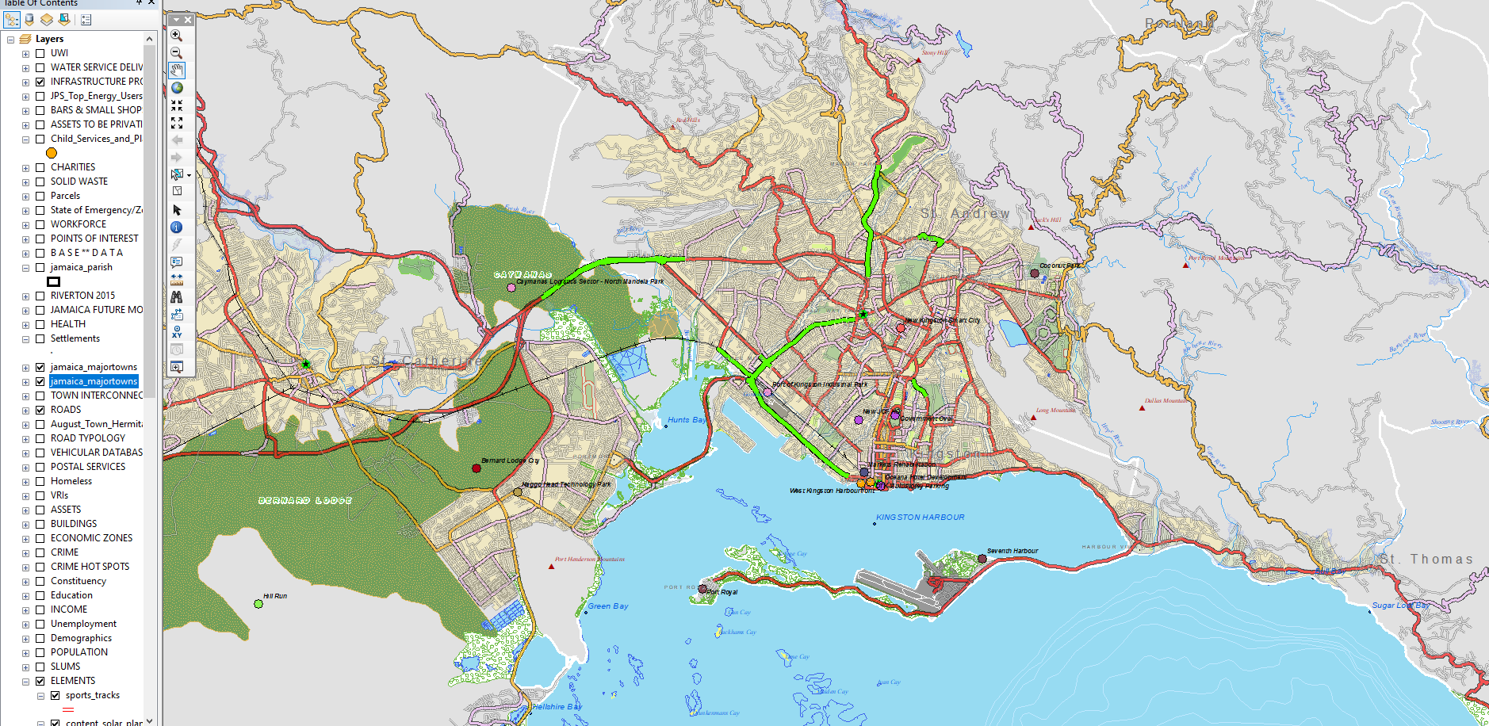
Major capital infrastructure projects currently planned or underway
Have major implications on movement of people as well as local property prices and investment potential

Slide 3
CHANGING ENVIRONMENT
Changes in population, buildings and tree cover
Increases in suburban and exurban development; connected to highway development
Increased densities of housing within KMA; patterns of gated communities
Urban renewal programs
Increased development along hill sides ringing city
14.5km² reduction in tree cover

Slide 4
CHANGING ENVIRONMENT
Building patterns increasing to the west of Kingston
Also patterns along hills ringing KMA
Patterns detect high-density building developments
Reduction in tree cover
Pattern most significant along hills ringing KMA
May have an impact on increasing volumes and velocities of runoff
Exacerbated downstream by gully blockages and poor maintenance, as well as encroachment

Slide 5
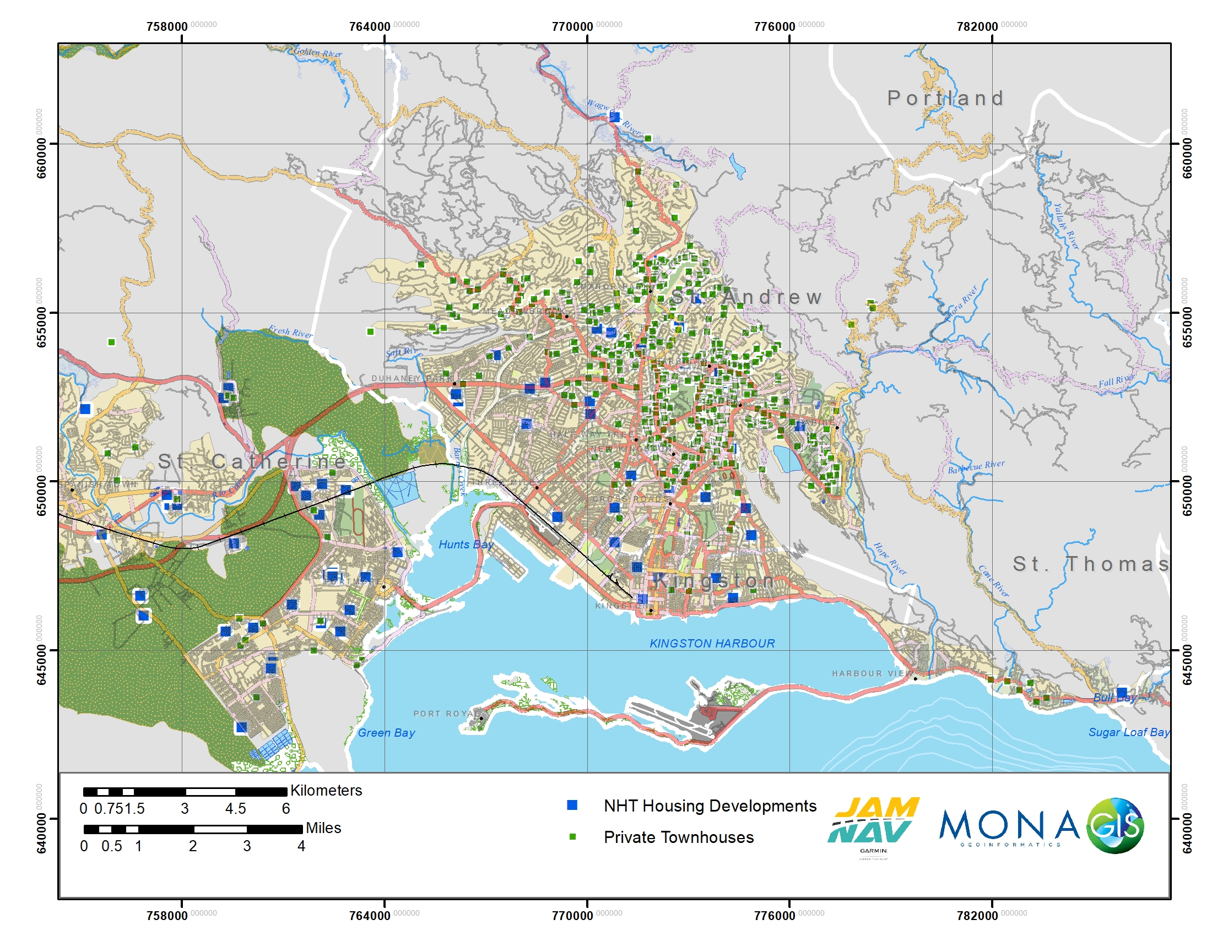

Slide 6
INFRASTRUCTURE
Critical corridors
Point-to-point routes
Evacuation routes
Emergency service routes
Critical transport facilities
Airports
Ports
Rail line
Supply, distribution and storage challenges
Variety of sources
Surface water
Spring-fed
Wells
One of most direct and widespread impacts of climate change

Slide 7
INFRASTRUCTURE

Slide 8
WATER QUALITY
Concerns about juxtaposition of low-quality groundwater and increasing pressure to drill wells
Predominantly high nitrate levels
Sewage networks do not cover entire city; still high numbers of soak-away pits and pit latrines
Pushback on flush toilets in unsewered area
Need for artificial recharge points to dilute and flush groundwater
Also for use of treated effluent for irrigation to reduce pumping of groundwater

Slide 9
DRAINAGE
Gully Network | Area (SqKm)
SANDY GULLY | 68.75
JEW | 7.65
SHOEMAKER | 6.67
FRANKLYN TOWN | 6.22
MOUNTAIN VIEW | 6.14
HUNTSBAY | 5.33
BARNES | 4.99
BALMAGIE | 4.62
TIVOLI/JONES TOW | 4.16
MARCUS GARVEY | 1.84
D'AGUILAR | 1.09

Slide 10
DEBRIS MODEL 1, 5, 10, 15 DAY MODEL
ASSUMPTIONS:
Normal flow conditions
Normal gully loading
7% of all garbage entering harbour leaves the harbour

Slide 11
FUTURE JAMAICA

Slide 12
Role of the Private Sector: Sink, Swim or Fly
SECTORS
JAMAICAN INITIATIVES
Financing
Loan/mortgage security
Investment decision-making
Innovations
Green tech
Alternative energy
Wastewater reuse
Engineering
Implementations
JN Water
Wigton
Plastic & Styrofoam Ban
Kingston Harbour
Use of treated effluent to recover costs of compliance

