Slide 1
Change Tomorrow Today Lessons Learned from Women in Leadership

Slide 2
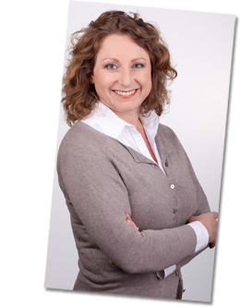
CLAUDIA
ZWART

Slide 3
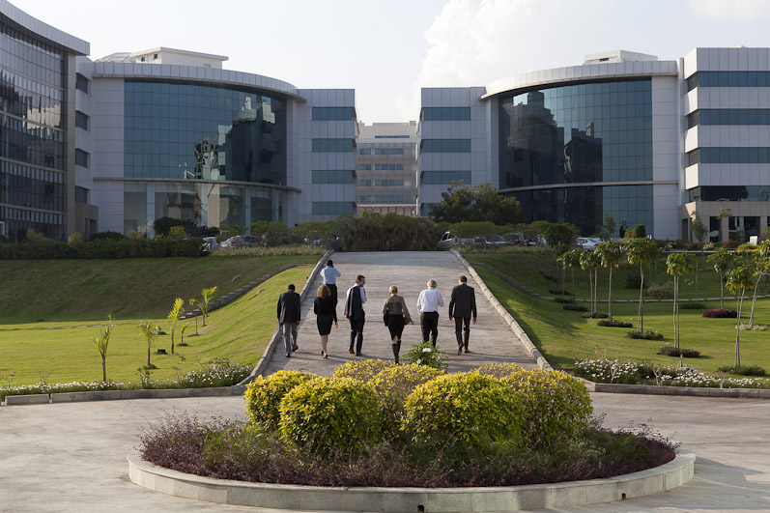

Slide 4
Global

Slide 5
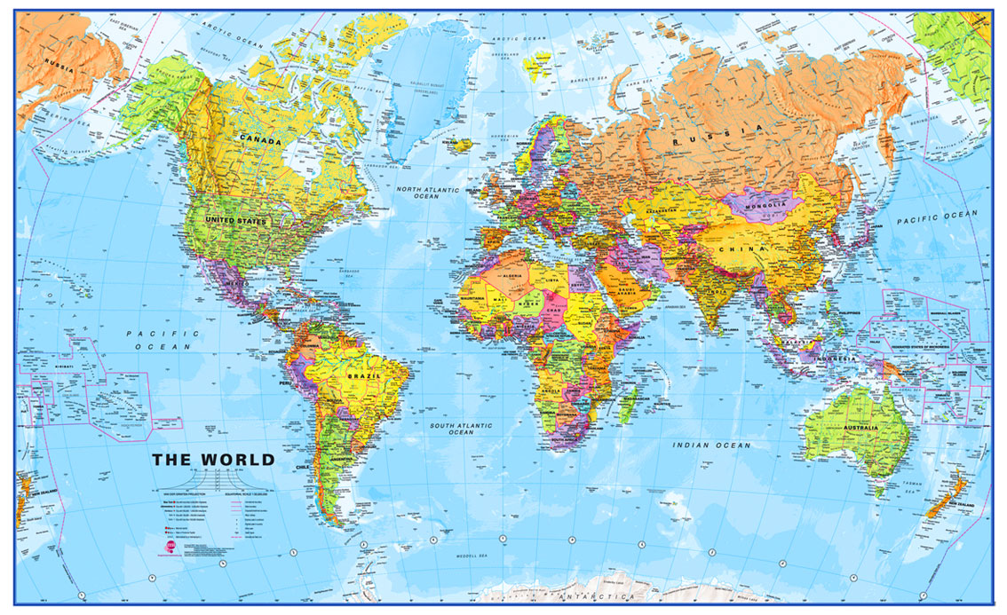
Global Research

Slide 6
Jobs

Slide 7
Jobs
Director People & Organisation
AVP Life Sciences Centre Head (Global Accounts)
Manager Learning & Development
Executive Manager
Global Programs Leader for Global Technology Service
Director
Owner
Boardmember Business Forum
Cofounder and Chair Women Business Group Micro Krediet
Head of City Police (700p)
Registeraccountant
Ondervoorzitter parlement
General Manager Food Business
Head Unit for Document Design
Director
Executive Chef
Company secretarial manager
Producer
Managing Director
Investor Real Estate
Digital Editor
Legal Boardroom Advisor
Director Innovation & Culture
Logistics Director
Managing Director
Founder and President
Corporate Communications Director
Trade Union Negotiator
Railway Director

Slide 8
Global Lessons

Slide 9
Career investments
Make choices
Marathon
or sprint
Do
Global view
Split families
Parents
Fear for live
Decision making
Think future
Clear Vision
Spirituality
Finance
Inclusivity
Commitment
Motherhood
Communication straight and clear
ambitious
Childhood
Diversity
Education
Human Rights
Apartheid
Young Leaders
Care for people

Slide 10
Act
Do unsual things
Investments
Lead by Mindmapping
Build connections
Broaden comfort zone
Role models
Lead unconditional
Breakthroughs
Pay forward
Social responsibility
Stop
Open
Comfort
Be different
TODAY
Belief
Simple
Develop
Cross the Line
Migration
Create To improve
Think change
Hapiness

Slide 11
Social Responsibility

Slide 12
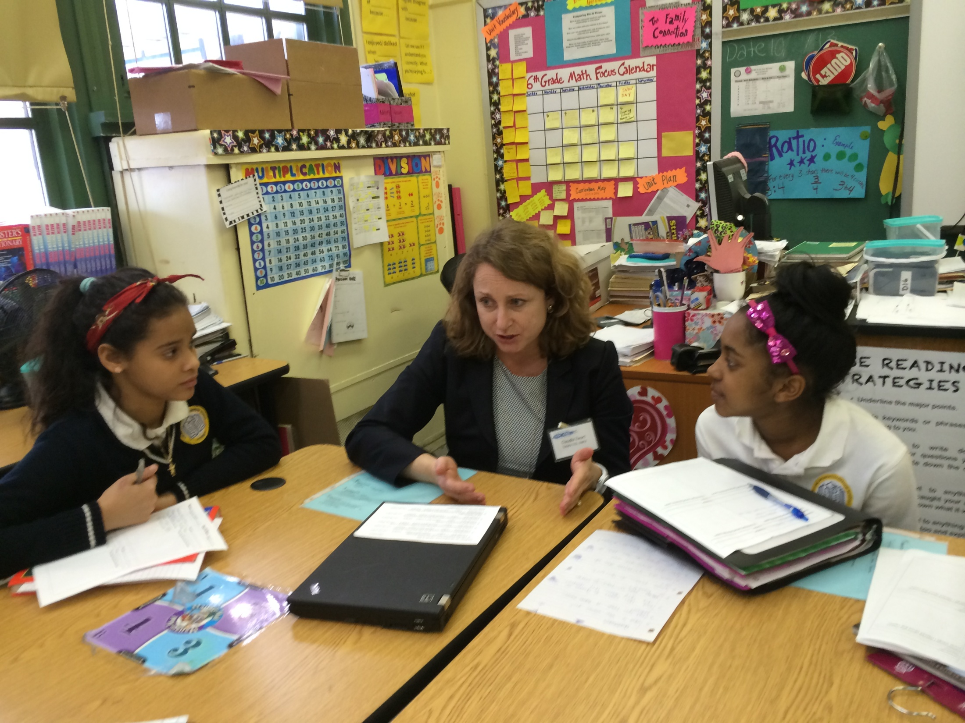

Slide 13
NEXT

Slide 14
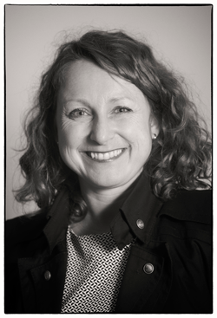
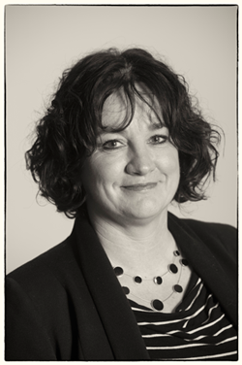
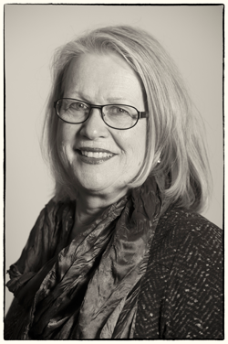
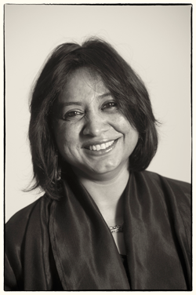
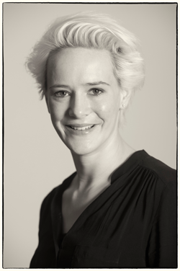
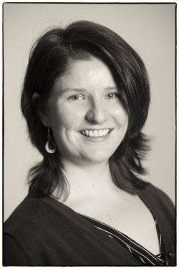
Team

Slide 15
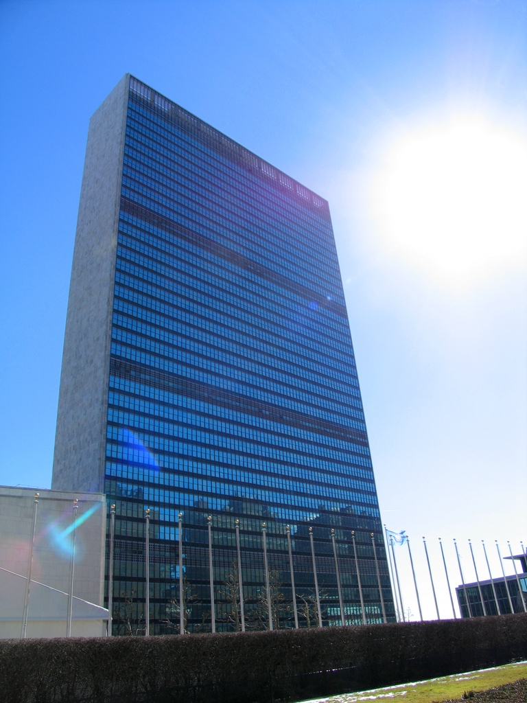
Change Tomorrow Today

Slide 16
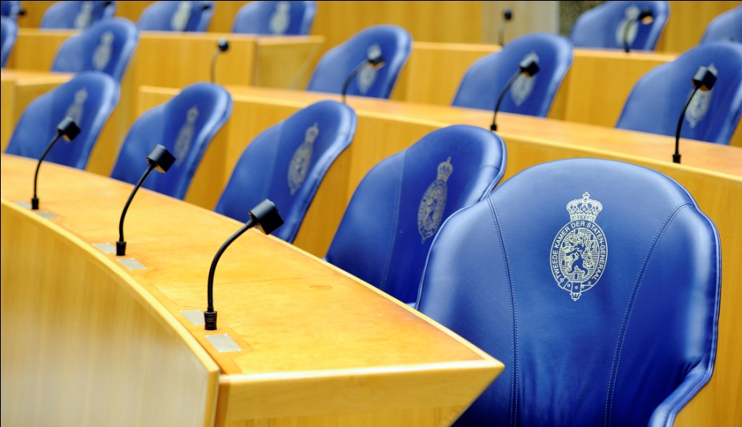
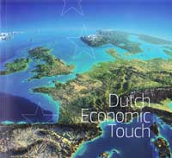
Renew European Economy

Slide 17
Science - PhD

Slide 18
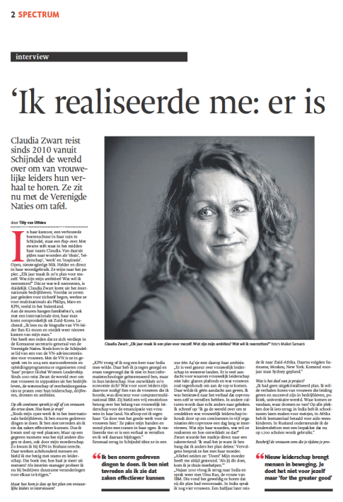
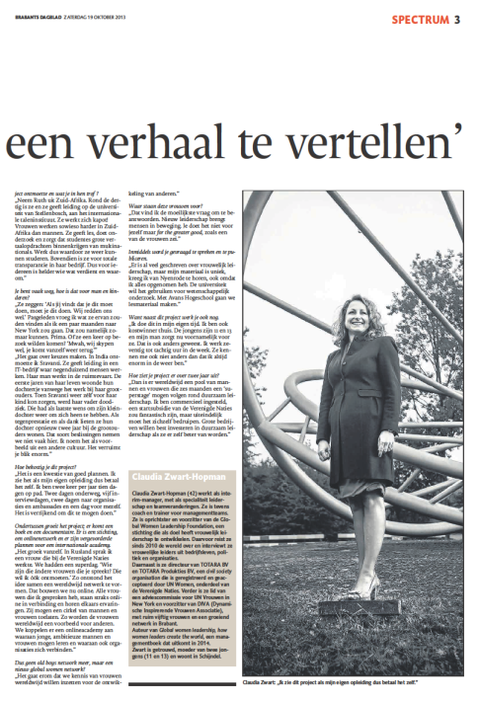
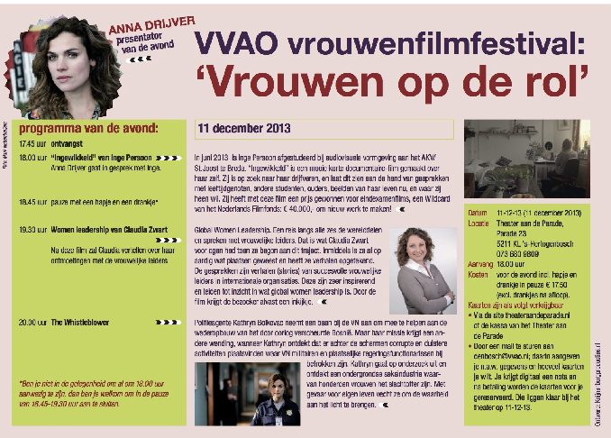
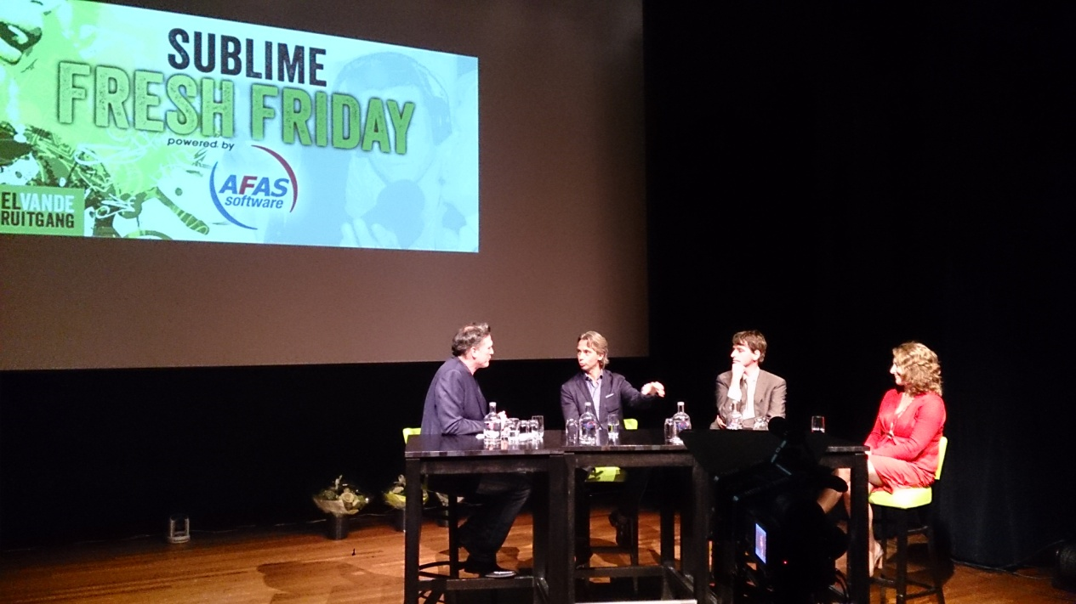
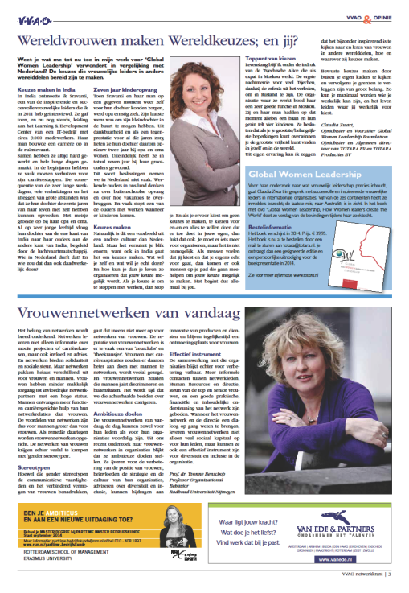
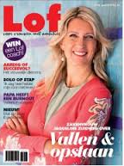
Media

Slide 19
Book

Slide 20
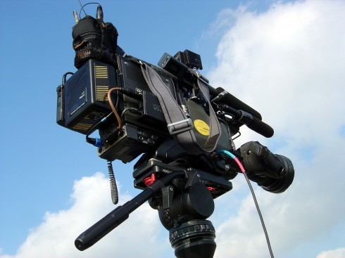
Film

Slide 21
Develop to Create a better Future

Slide 22
Lessons Learned
INDIAN
Women
LEADERS
South African WOMEN LEADERS
CZECH/RUSSIAN WOMEN LEADERS

Slide 23
Unknown for Growth

Slide 24
Accountancy Professional

Slide 25
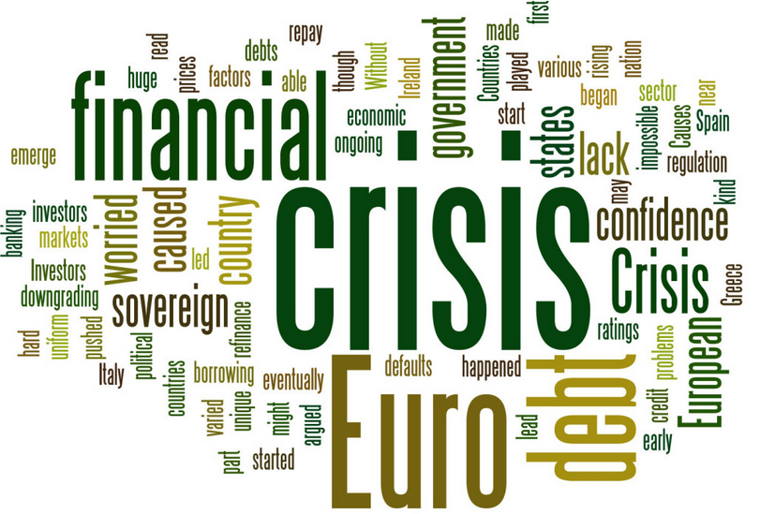
Crisis

Slide 26
Vision

Slide 27
To be a role model for New Leadership
Vision

Slide 28
Values

Slide 29
INTEGRITY SOCIETY OVER SELF LIVE AND LET LIVE (respect diversity) HUMANITY ETHICS
Values

Slide 30
How to
Change Tomorrow Today

Slide 31
Today

Slide 32
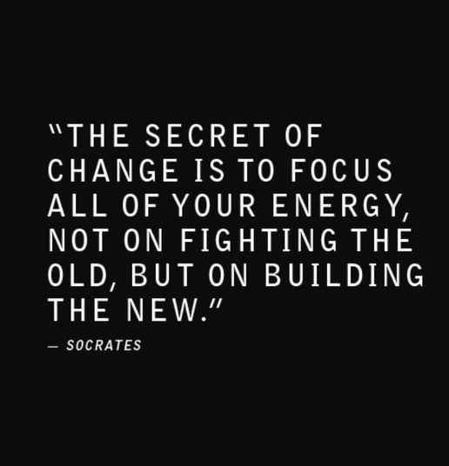
Change

Slide 33
Tomorrow

Slide 34
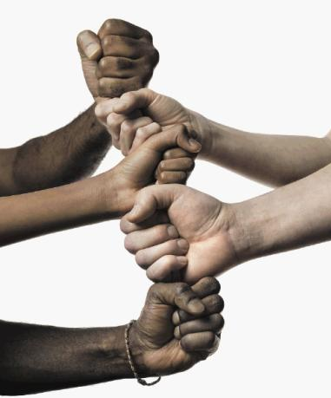
Society over Self

Slide 35
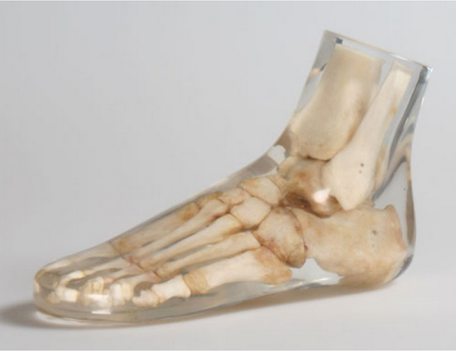
Clear & Transparant

Slide 36
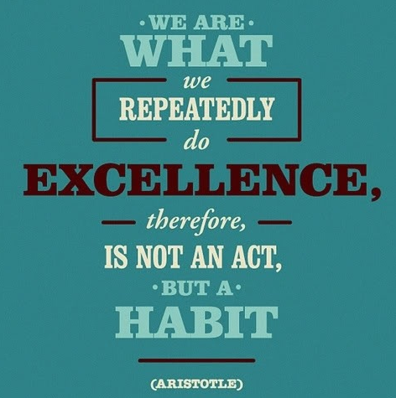
Our Shared Future

Slide 37
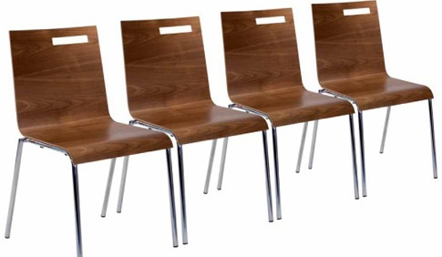
WE INVITE YOU !

Slide 38
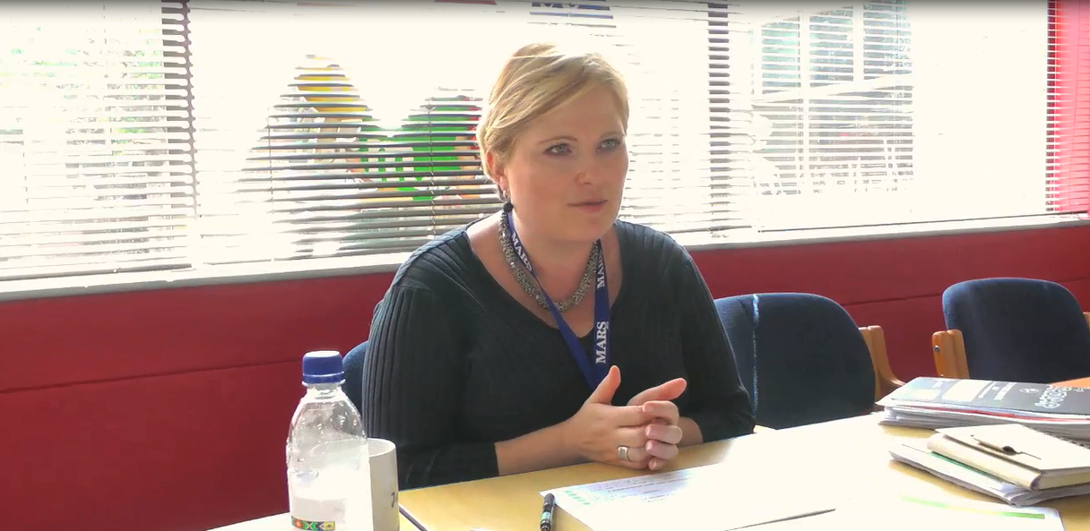
Jeanne, MARS, South Africa

Slide 39
IT IS ABOUT THE GREATER GOOD, NOT ABOUT ME - Jeanne
1

Slide 40
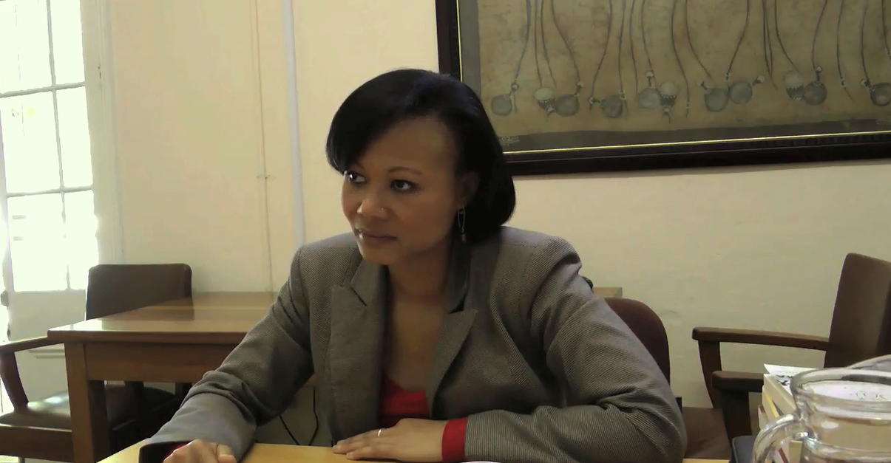
Ruth, University Stellenbosch, South Africa

Slide 41
YOU DON’t NEED A TITLE TO BE A LEADER for SYSTEMIC CHANGE - Ruth
2

Slide 42
Ameeta Roy, IBM, India

Slide 43
WE SHOULD NOT COMPRoMISE ON INTEGRITY - Ameeta
3

Slide 44
Michelle, Open Source, South Africa

Slide 45
leadership is hard WORK and requires a lot of communicatiONS - Michelle
4

Slide 46
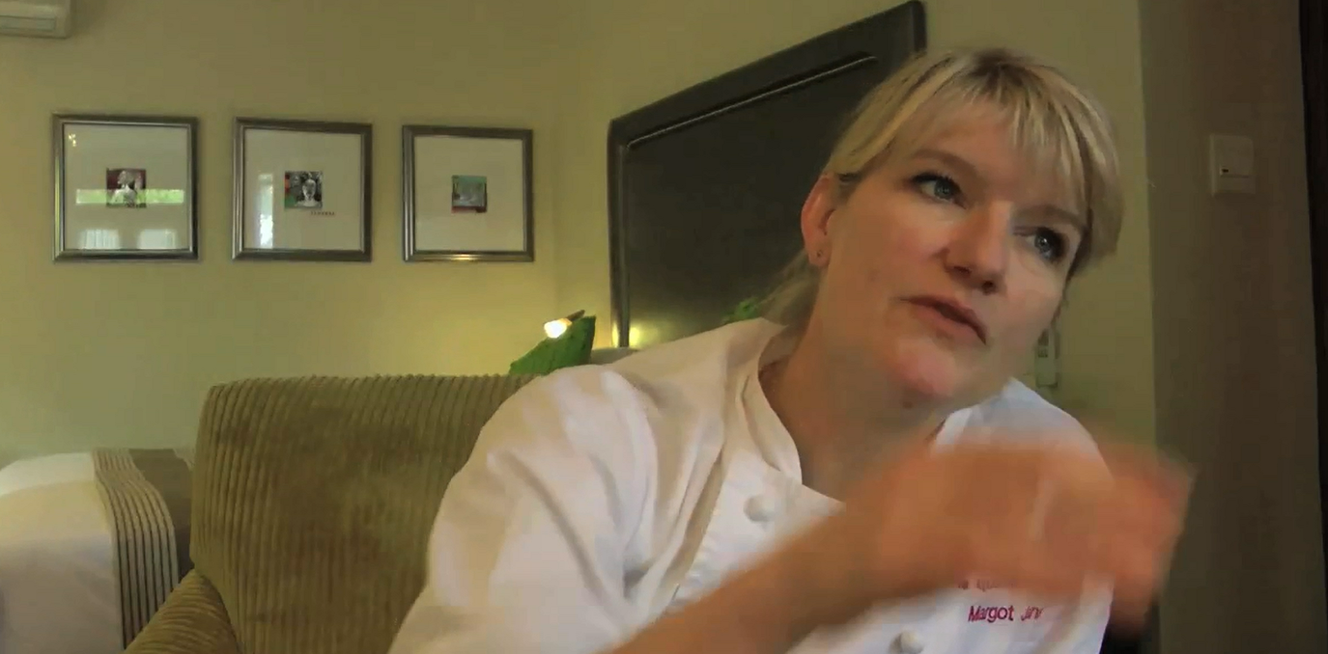
Margot, Executive Chef, South Africa

Slide 47
selected out of the group with all the diploma’s - margot
5

Slide 48
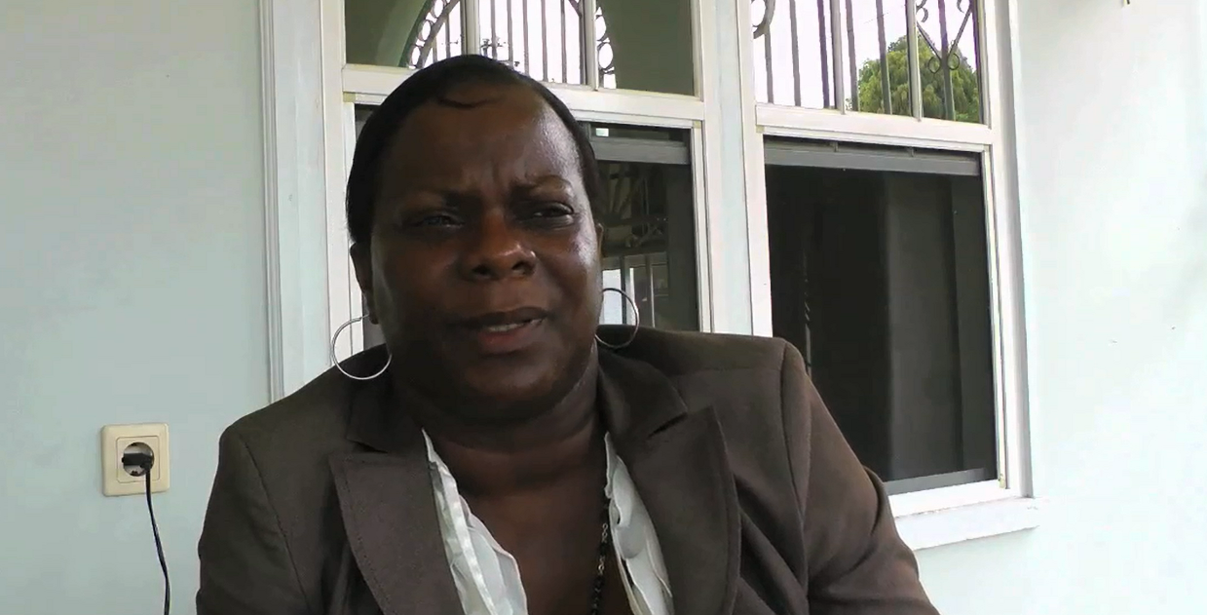
Yvonne, Chartered Accountant, SUVA, Suriname

Slide 49
IF YOU want to change something, You have to do something for it - yvonne
6

Slide 50
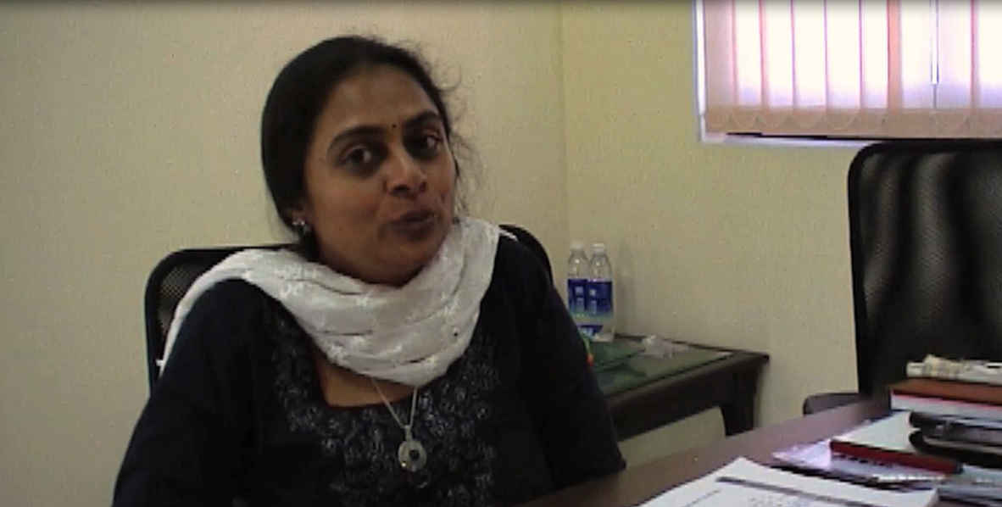
Sravanti, Infotech, India

Slide 51
BELIEF IN THE PROJECT - Sravanti
7

Slide 52
Change Tomorrow TodaY!
Because it matters

